Slide 1
Мини-цикл: Изображение и воображение
Запечатлеть неуловимое: символы огня и света в ашкеназских синагогах
Илья Родов
Notes:
1

Slide 2
Связь между мирами

Slide 3
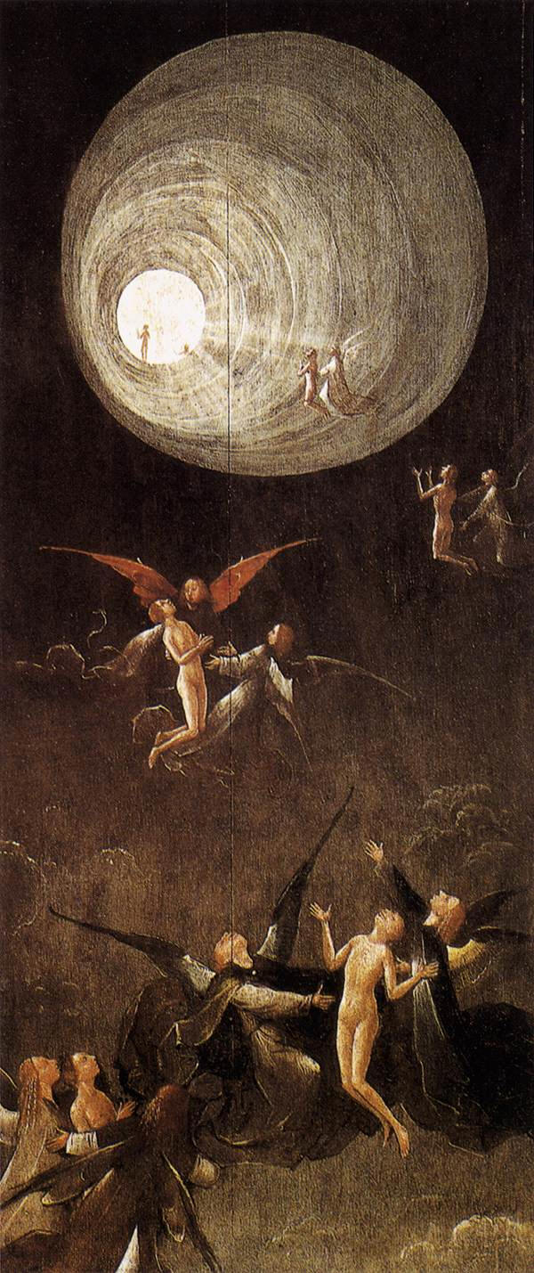
Hieronymus Bosch, Paradise: Ascent of the Blessed, 1500-04 Oil on panel, 86,5 x 39,5 cm. Palazzo Ducale, Venice

Slide 4
Прихоть архитектора или символ?

Slide 5
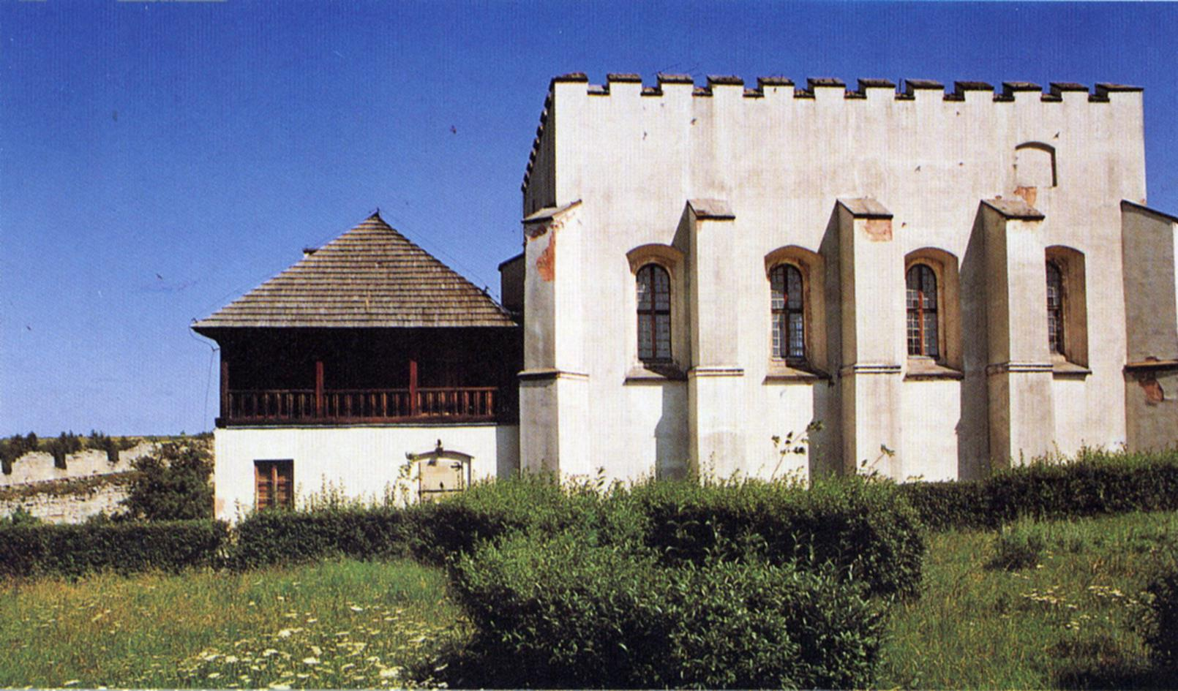
Szydłow, Synagogue. Southern facade, 1534–64 and later reconstructions and additions.

Slide 6
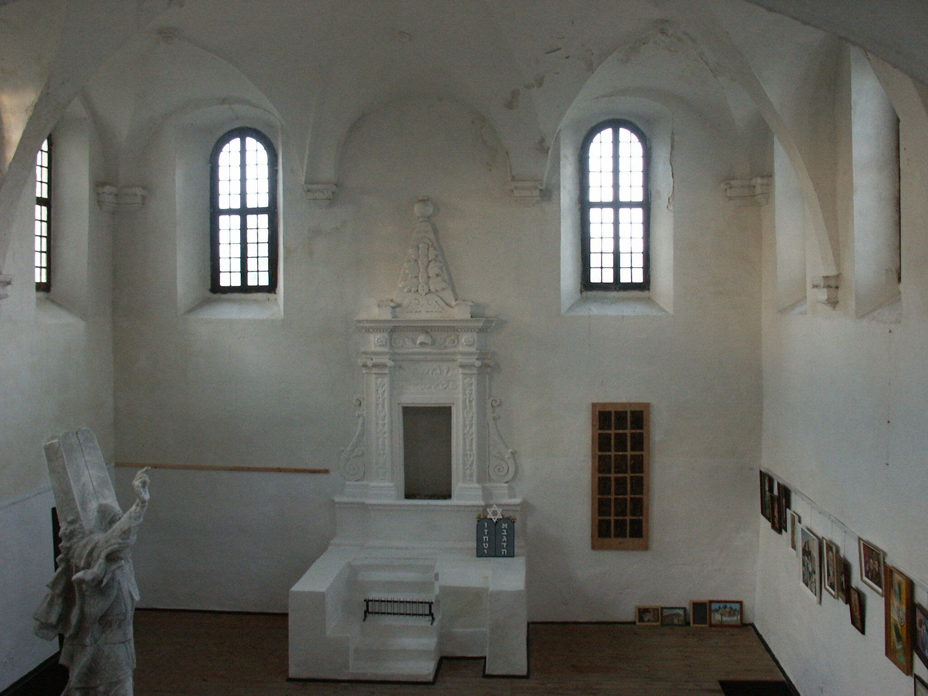

Slide 7
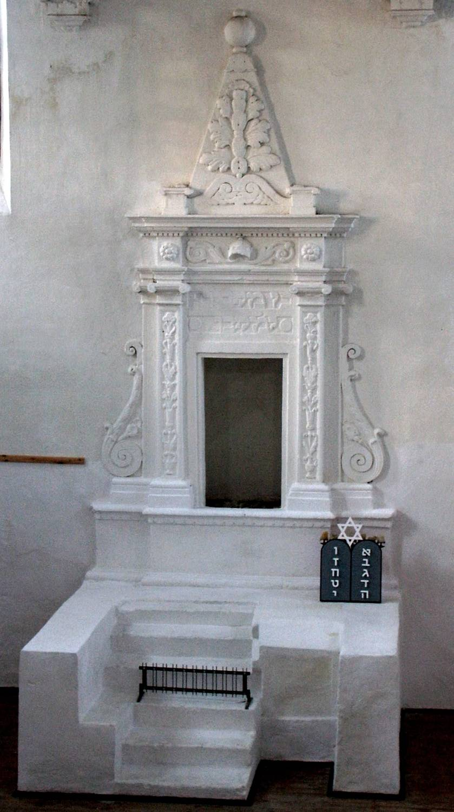
Szydłow, Synagogue. Torah ark.

Slide 8
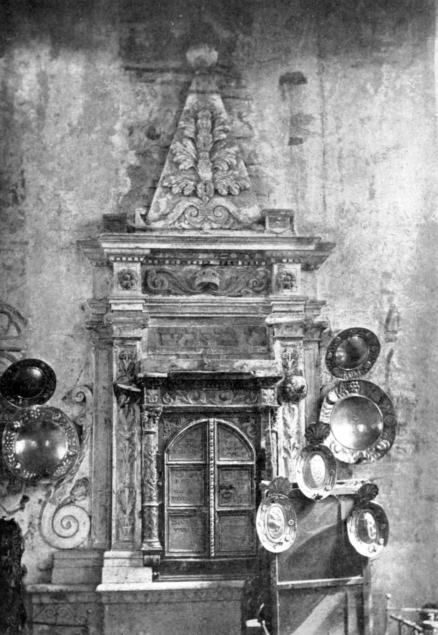
Пирамида?
Szydłow, Synagogue. Torah ark.

Slide 9
Пирамида?

Slide 10
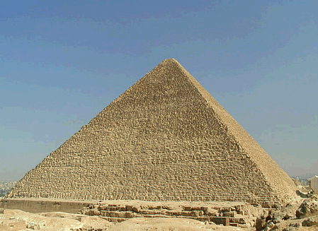
Khufu

Slide 11
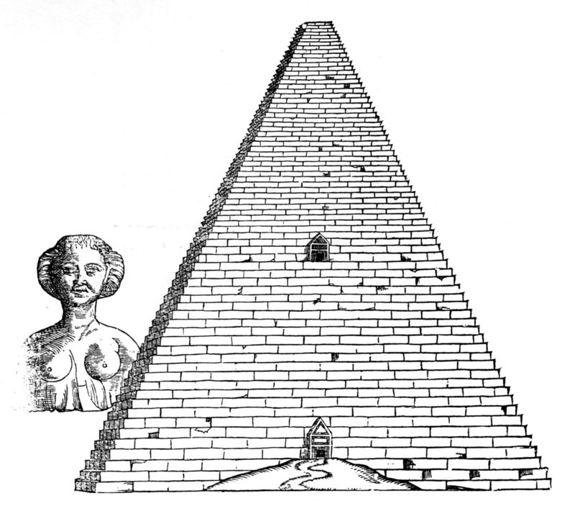
Pyramid of Cheops and Sphinx, in Serlio, Il terzo libro di architettura (Venice, 1540), , fol. 94.

Slide 12
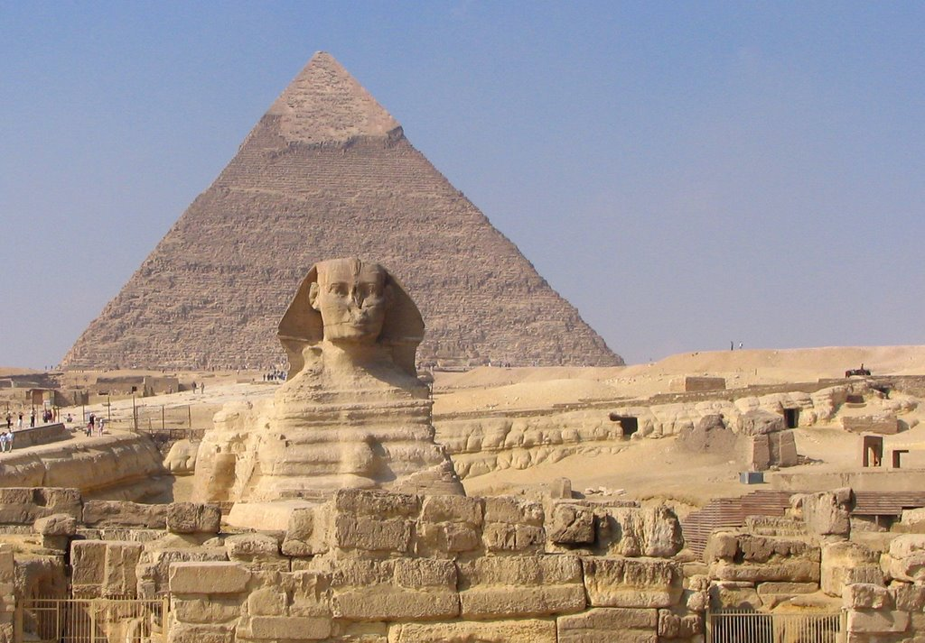
Pyramid of Cheops and Sphinx, in Serlio, Il terzo libro di architettura (Venice, 1540), , fol. 94.
Khafra

Slide 13
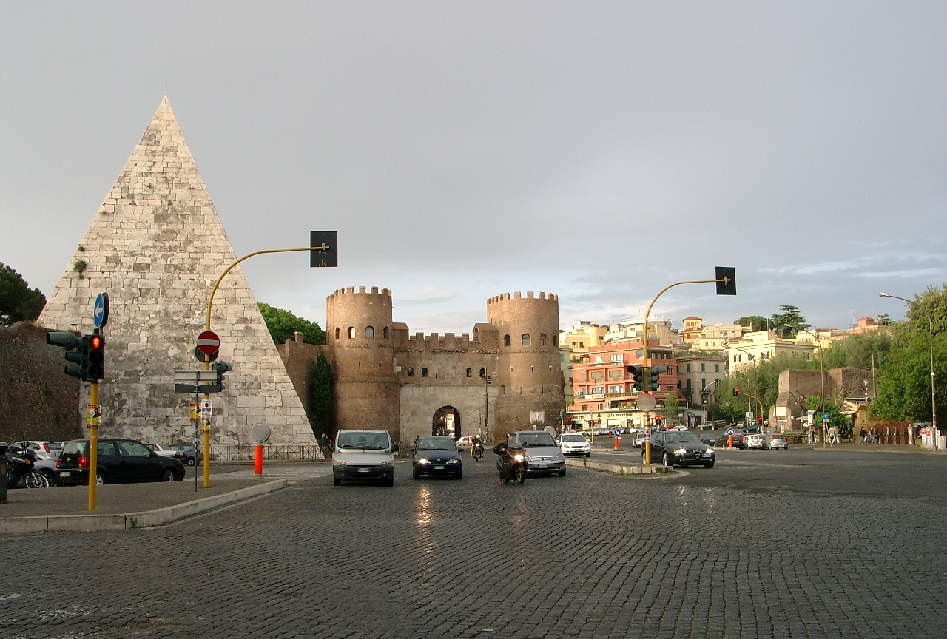
. Pyramid of Cestius, 12 B.C.E. Rome, Gate of Ostiensis

Slide 14
Обелиск?
Szydłow, Synagogue. Torah ark.

Slide 15
Обелиск?

Slide 16
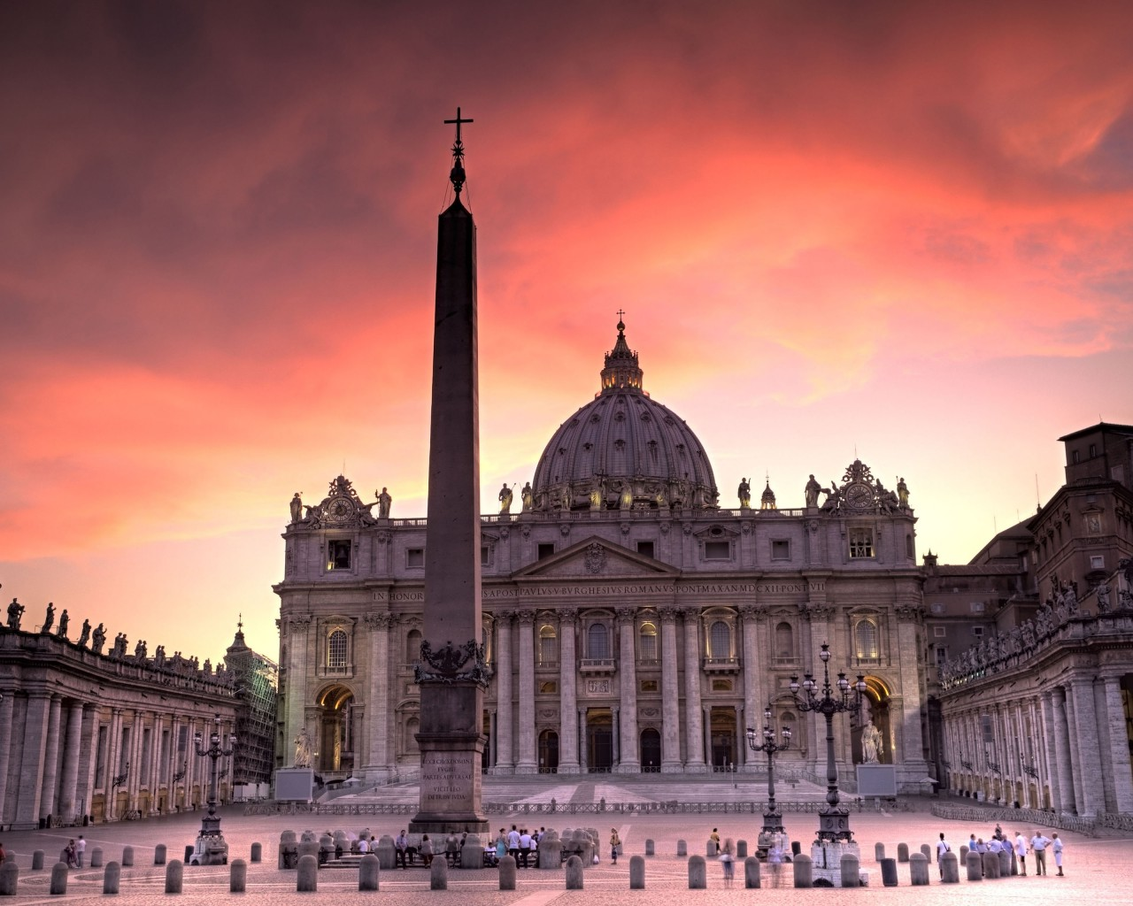

Slide 17
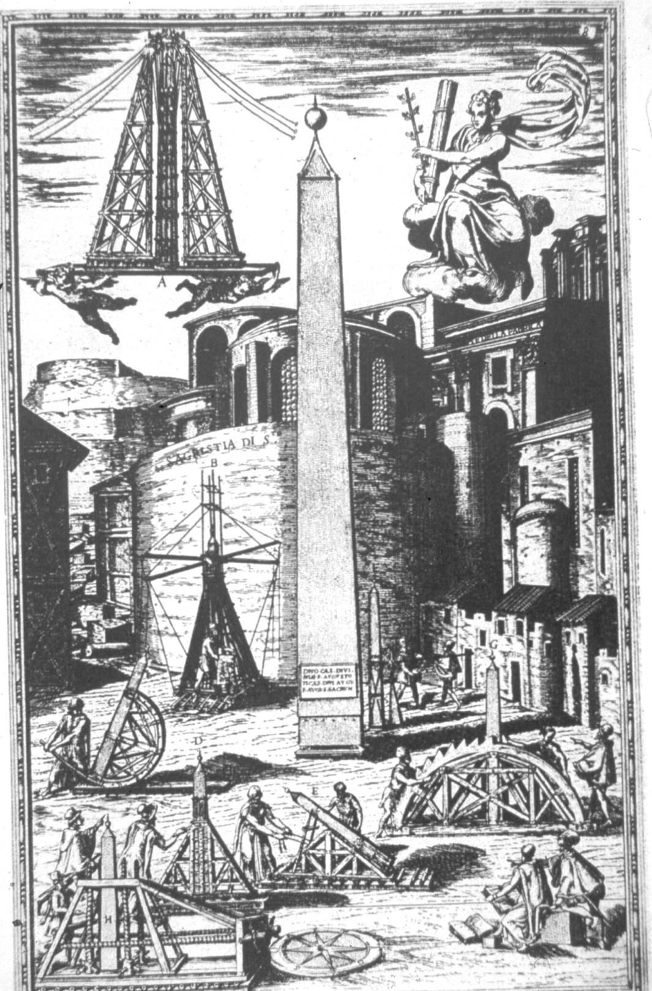
Relocation of the obelisk at St. Peter’s

Slide 18
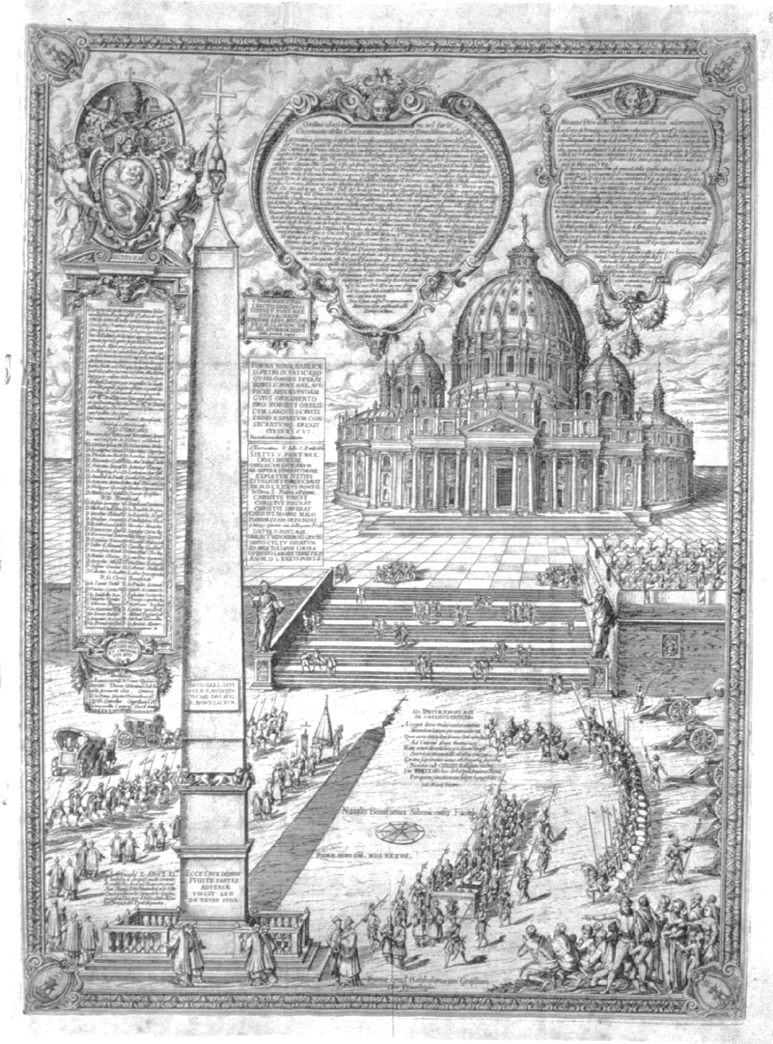
The obelisk at St. Peter’s (Sixtus 5, 1585-90)

Slide 19
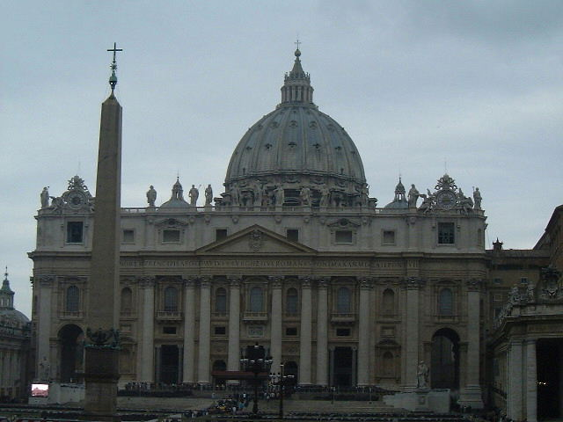

Slide 20
Obelisk at St. Peter’s in Vatican, Sebastiano Serlio, Il terzo libro di architettura (Venice, 1540), fol. 68

Slide 21
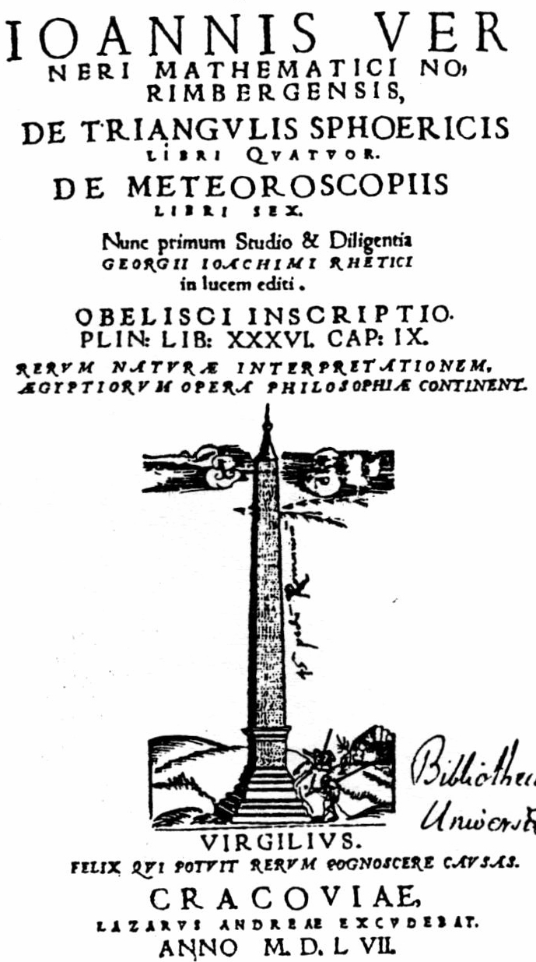

Slide 22
Пирамида-обелиск

Slide 23
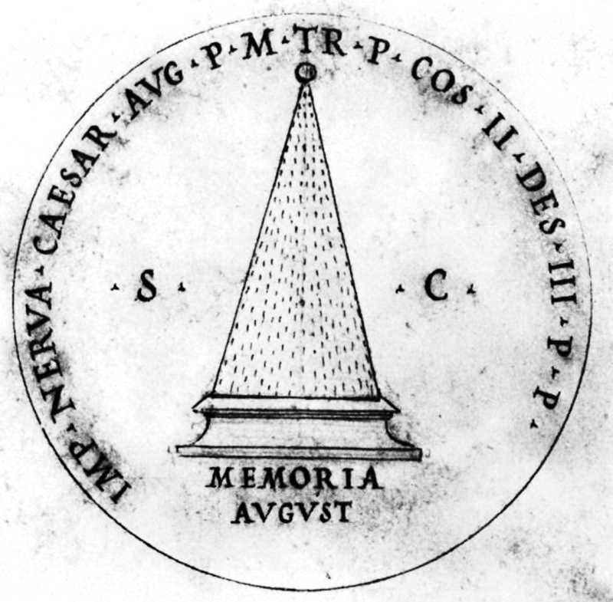

Slide 24
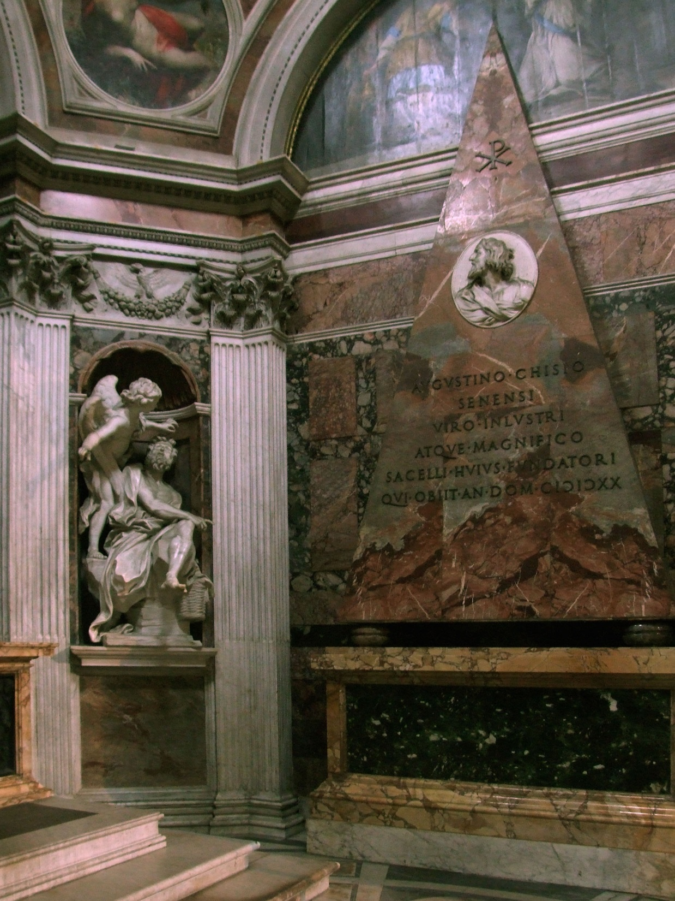
Кардинал Эгидио да Витербо, приор Августианского ордена, ответственного за Санта Мария дель Пополо:
Пирамида – символ наиболее пламенных языков Божественной любви, пронизывающей землю и небо.
Raphael, Tomb of Agostino Chigi, 1513–16, altered by Gian Lorenzo Bernini, 1652. Rome, S. Maria del Popolo, the Chigi Chapel.

Slide 25
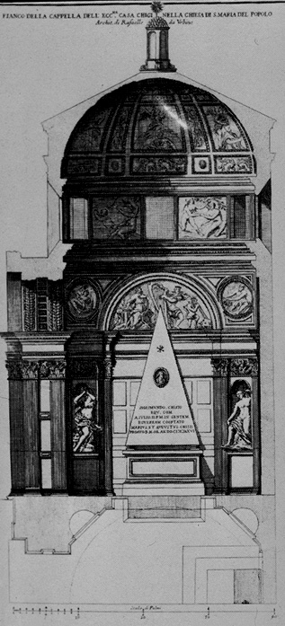
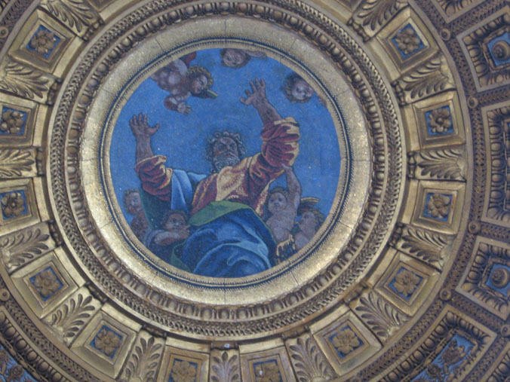
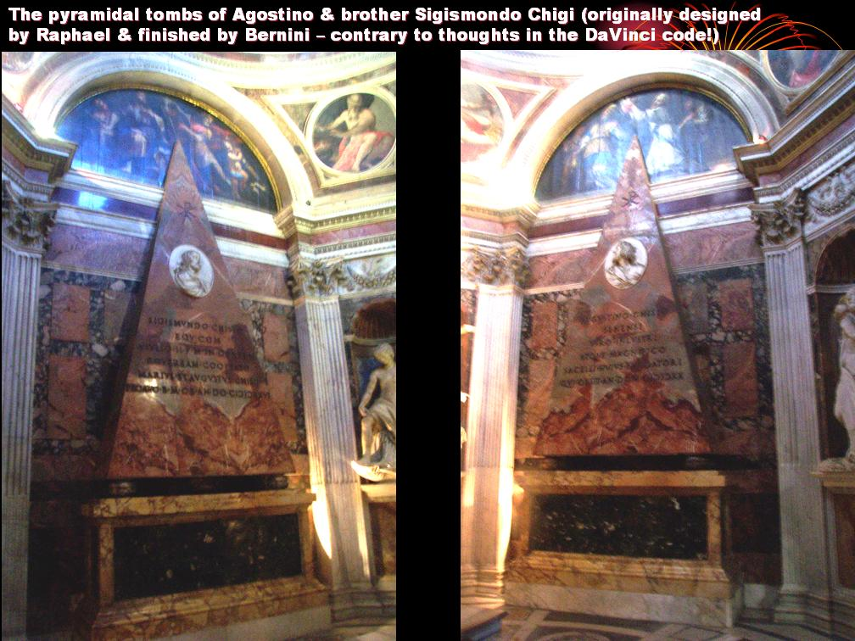
Rome, S. Maria del Popolo, the Chigi Chapel, by Raphael, 1513–16; altered by Gian Lorenzo Bernini, 1652.

Slide 26
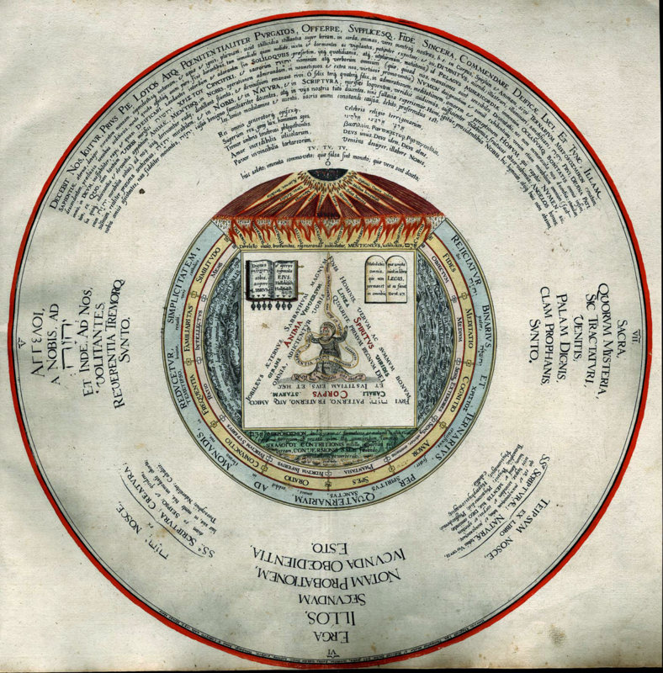
Heinrich Khunrath (1560–1605), Amphitheatrum sapientiae aeternae, Hamburg, 1595

Slide 27
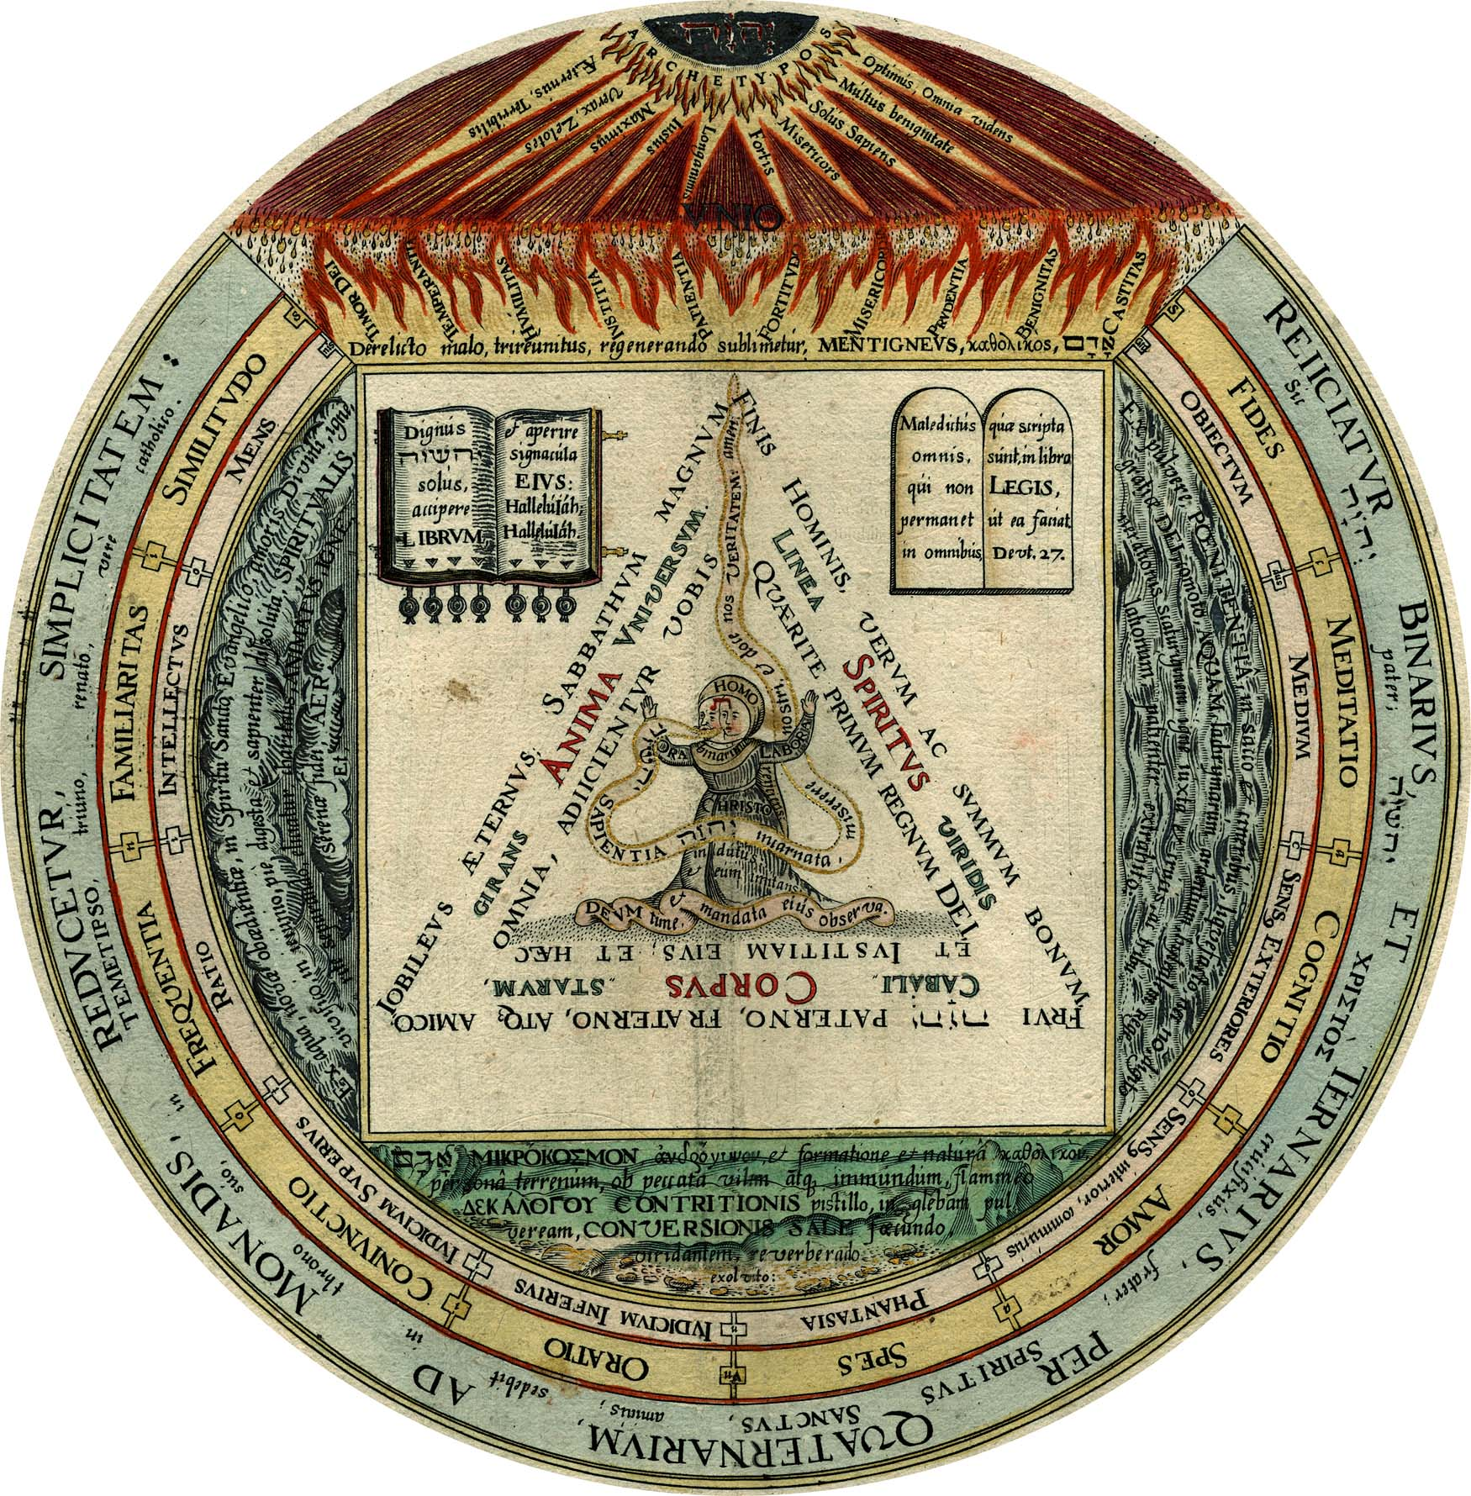

Slide 28
Пирамида-обелиск: из Италии в Польшу

Slide 29
Raphael, Tomb of Agostino Chigi, 1513–16, altered by Gian Lorenzo Bernini, 1652. Rome, S. Maria del Popolo, the Chigi Chapel.

Slide 30
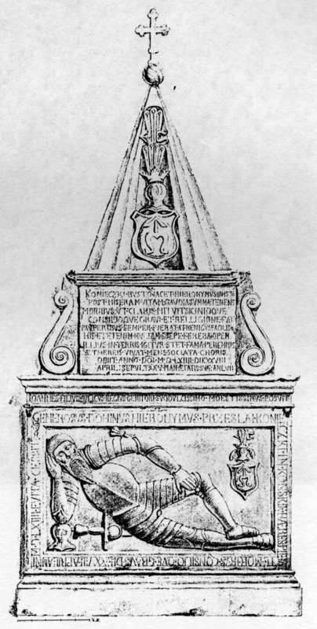
Końskie, Saint Nicholas Collegial Church. Tomb of Hieronim Koniecki (d. 1564). Drawing by Maksymilian Cercha, before 190

Slide 31
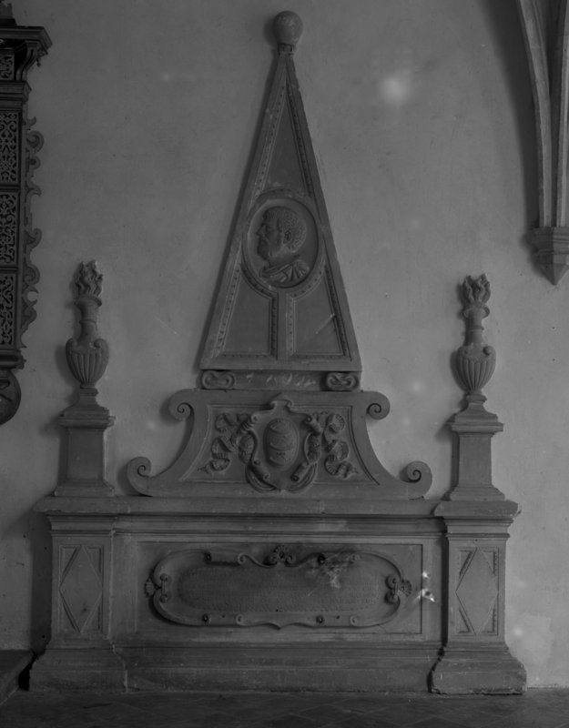
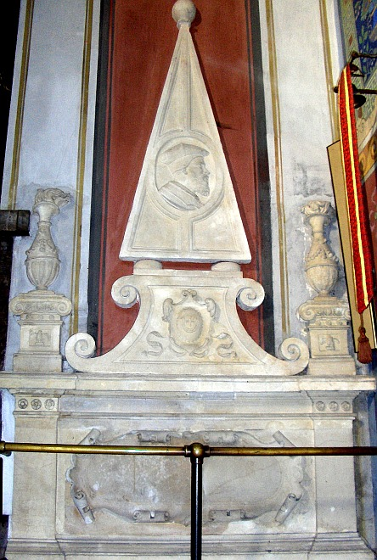
Cracow, Cloister in the Dominican Church. Santi Gucci, Tomb of Galeazzo Guicciardini, ca. 1557.
Santi Gucci’s workshop, Tomb of Wojciech Sobieński, the early 1560s. Płock, Cathedral

Slide 32
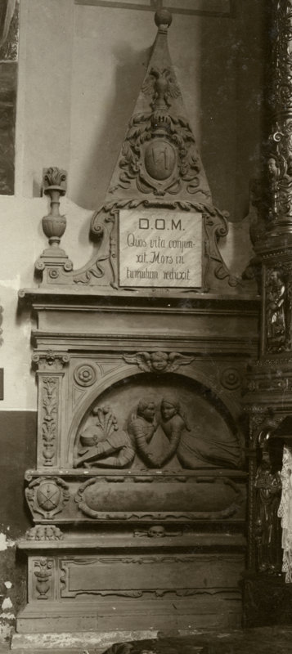
Kraśnik, St. Mary’s Ascension Church. Santi Gucci, Tomb of a son and daughter of Andrzej Tęczyński and Zofĳia Dembowska, before 1579.

Slide 33
Надгробие и ковчег

Slide 34
Kraśnik, St. Mary’s Ascension Church. Santi Gucci, Tomb of a son and daughter of Andrzej Tęczyński and Zofĳia Dembowska, before 1579.
<<< Szydłow, Synagogue. Torah ark.

Slide 35
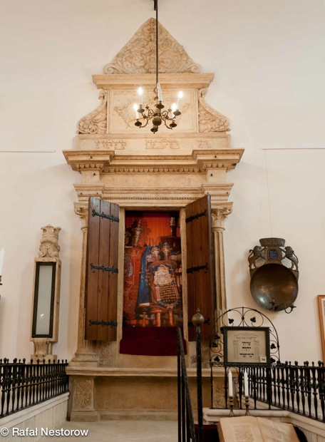
Szydłow, Synagogue. Torah ark.
Kazimierz (Cracow), Old Synagogue. Torah ark.

Slide 36
Древо жизни и неугасимый пламень

Slide 37
Kraśnik, St. Mary’s Ascension Church. Santi Gucci, Tomb of a son and daughter of Andrzej Tęczyński and Zofĳia Dembowska, before 1579.
<<< Szydłow, Synagogue. Torah ark.

Slide 38
Szydłow, Synagogue. Torah ark.
Kazimierz (Cracow), Old Synagogue. Torah ark.

Slide 39
Szydłow, Synagogue. Torah ark.

Slide 40
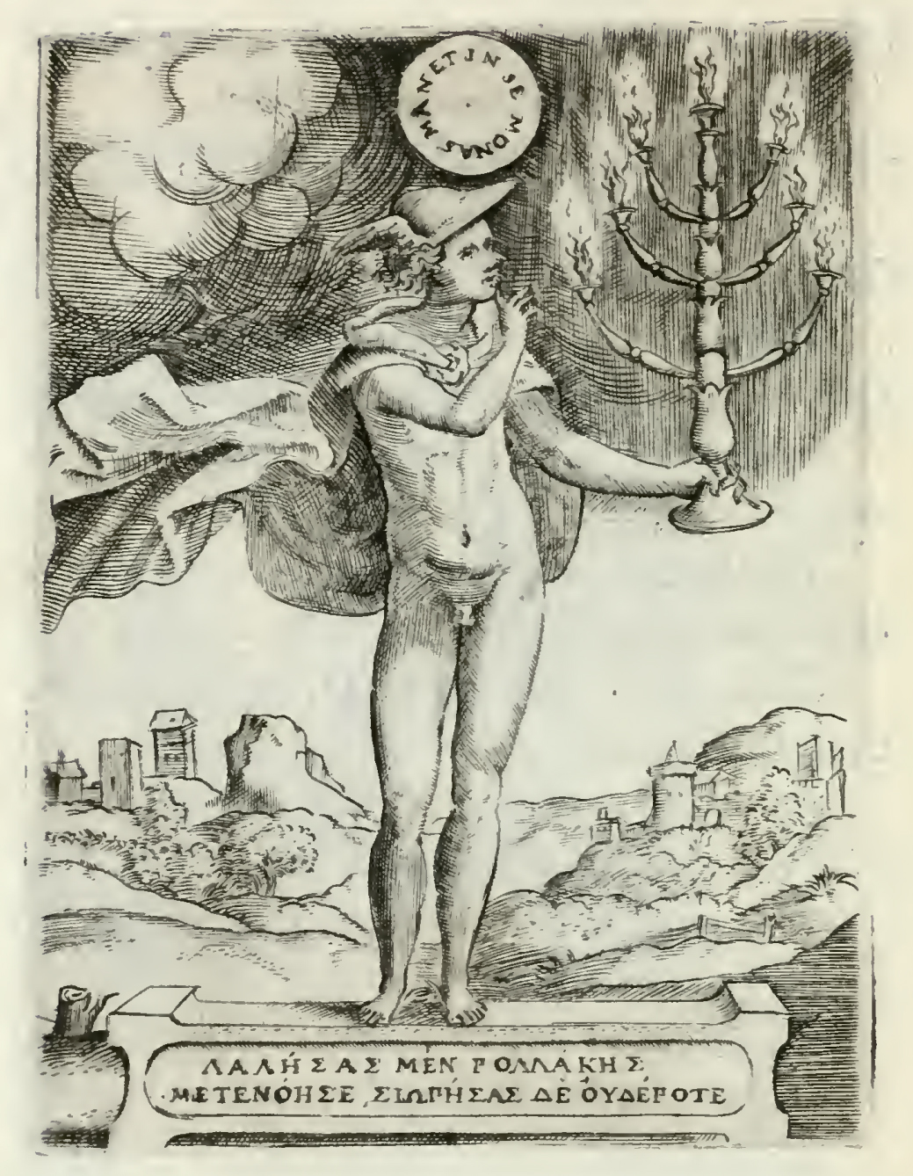
Worship God in Silence, Achille Bocchi’s Symbolicarum quaestionum, 1555
Silentio Deum cole

Slide 41
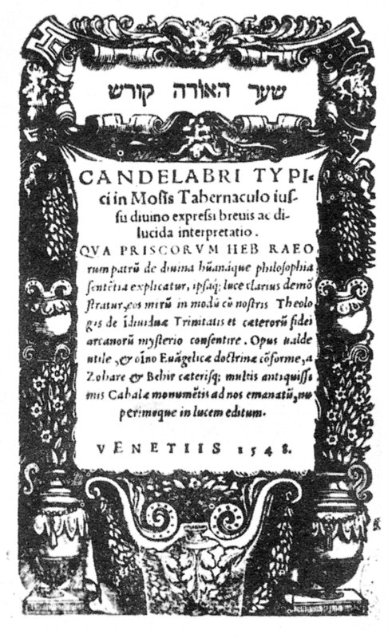
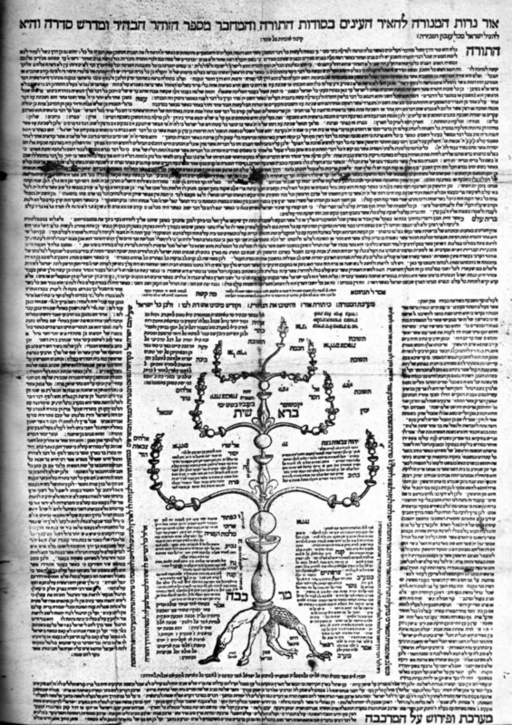
Guillaume Postel, Candelabri typici in Mosis abernaculo (Venice, 1548), frontispiece.
Guillaume Postel, Or nerot ha-Menorah ([s. l.], 1547[?]).

Slide 42
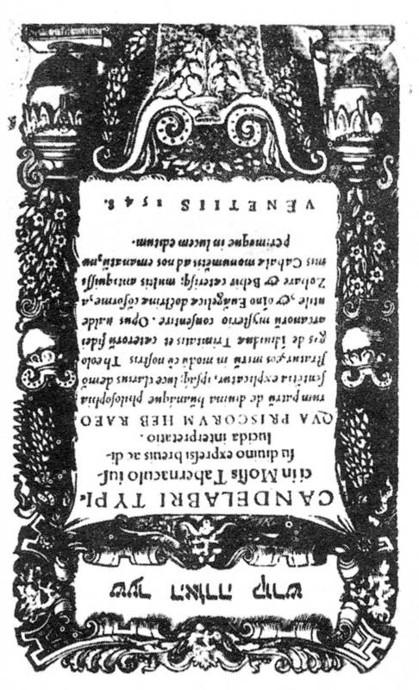
Szydłow, Synagogue. Torah ark.
Guillaume Postel, Candelabri typici in Mosis abernaculo (Venice, 1548), frontispiece.

Slide 43
Szydłow, Synagogue. Torah ark.

Slide 44
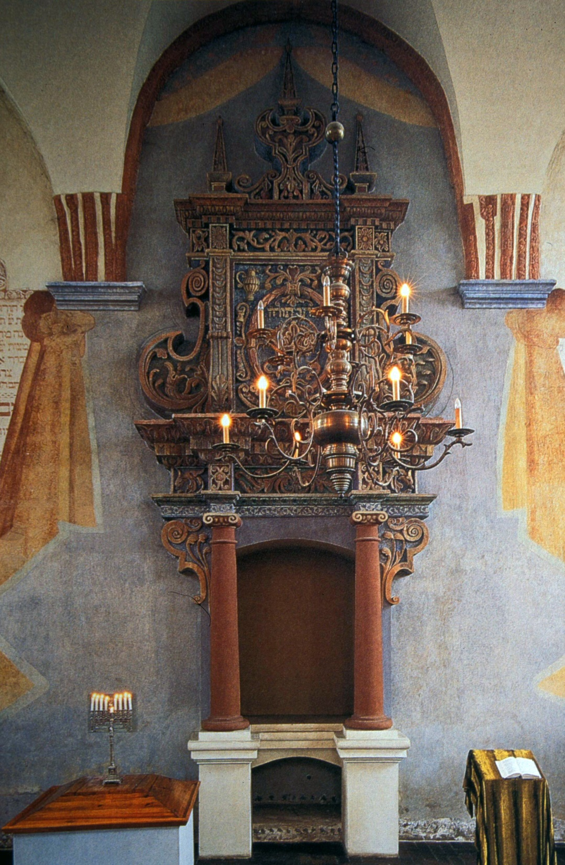
Tykocin, Synagogue. Torah ark.

Slide 45
Пламя жертвенника

Slide 46
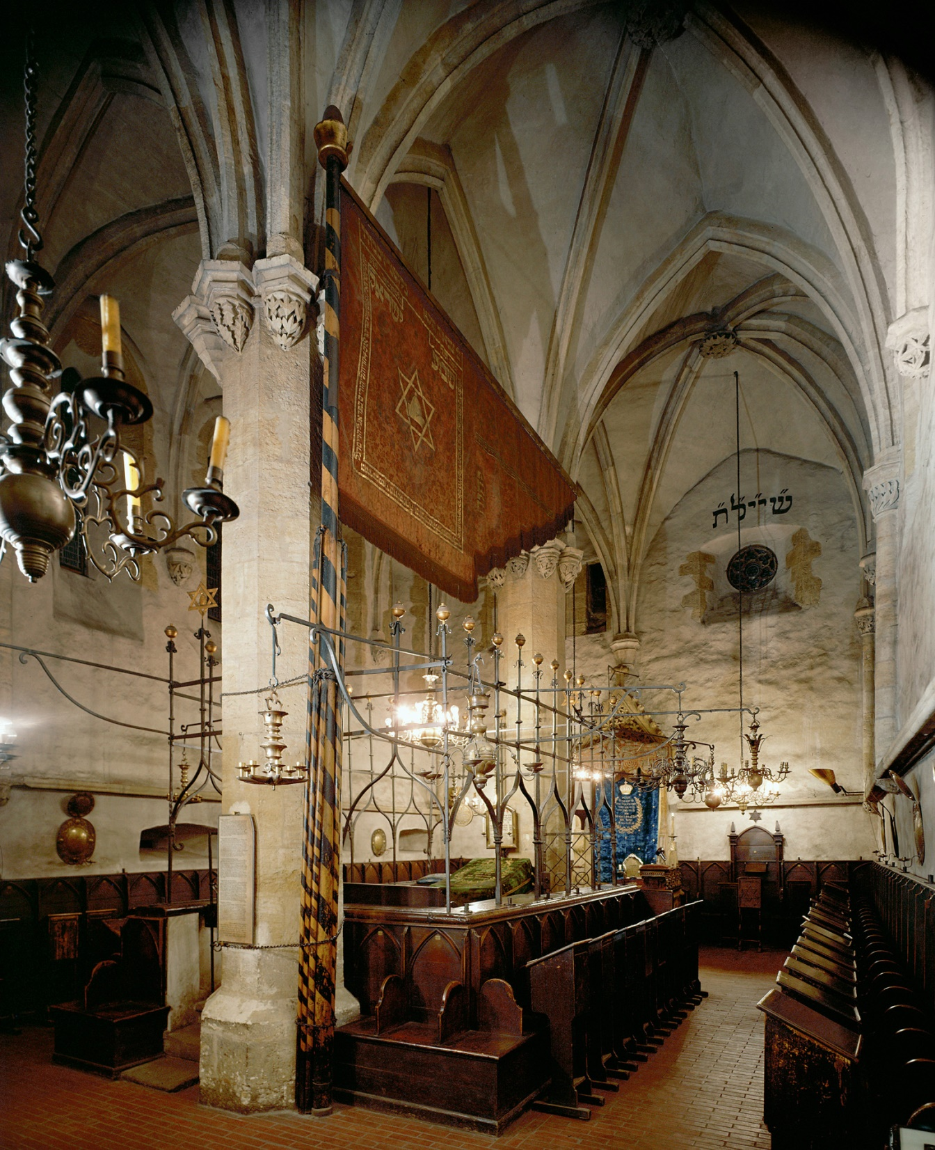
Prague, Altneuschul, late 13th century

Slide 47
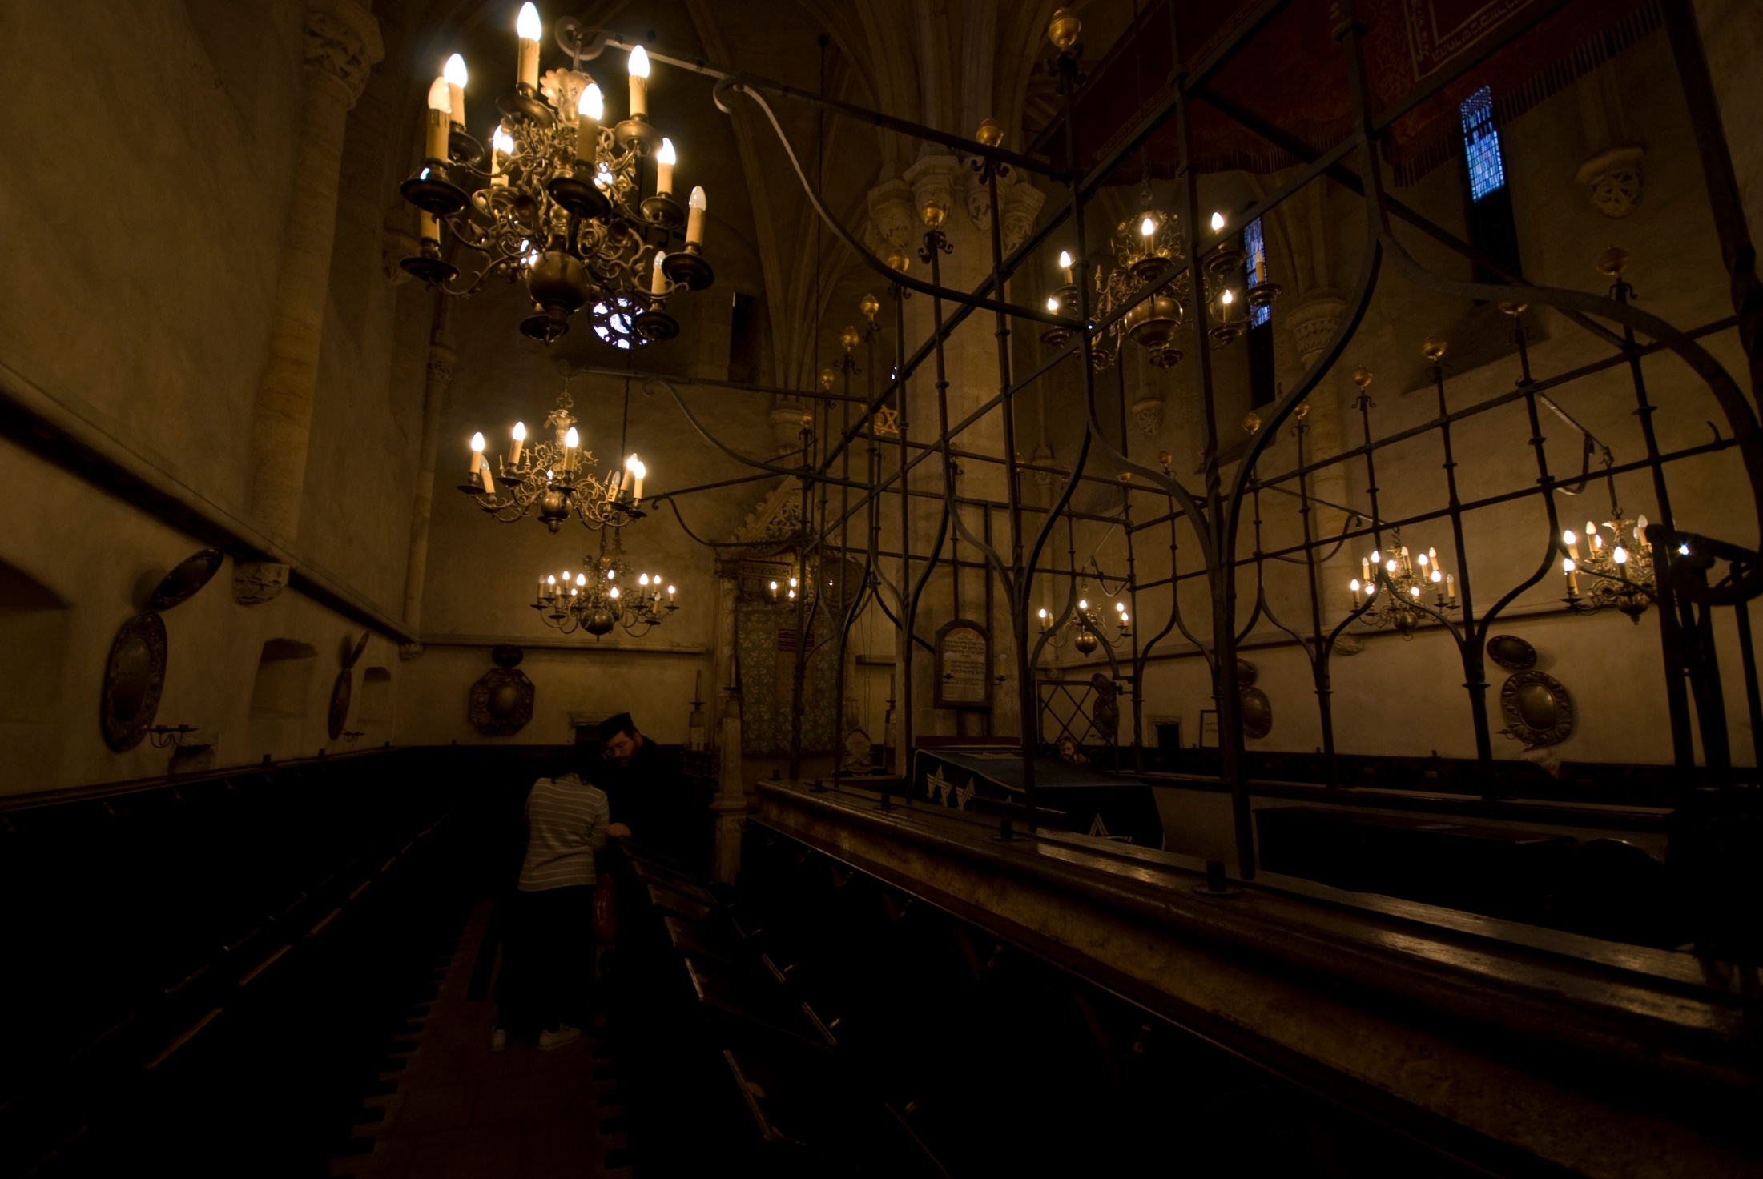
Prague, Altneuschul, late 13th century

Slide 48
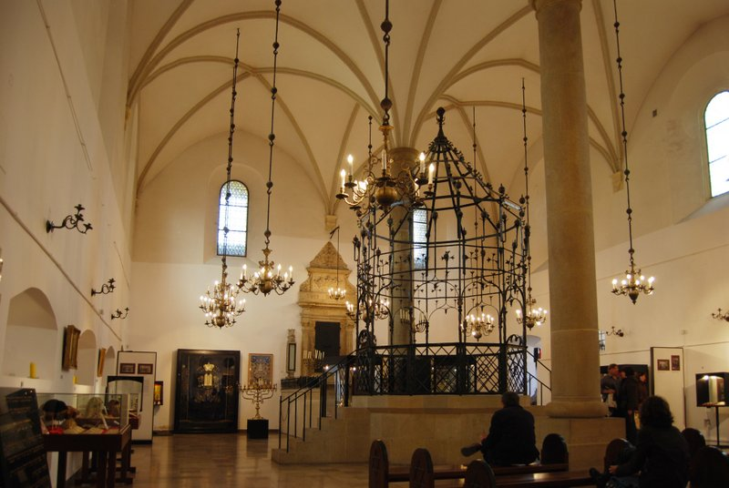
Kazimierz (Cracow), Old Synagogue.

Slide 49
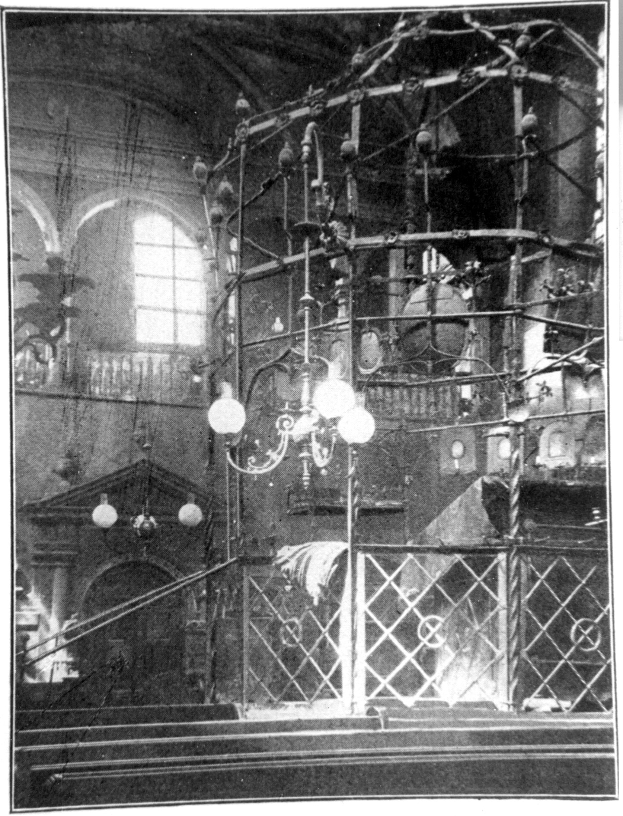
Kazimierz (Cracow), Isaac’s Synagogue. Bimah.

Slide 50
Końskie, Saint Nicholas Collegial Church. Tomb of Hieronim Koniecki (d. 1564). Drawing by Maksymilian Cercha, before 190
Kazimierz (Cracow), Old Synagogue: Bimah

Slide 51
“Bimah in the Old Synagogue in Kazimierz.” Drawing, ca. 1869 (from Essenwein, Die mittelalterlichen Kunstdenkmale der Stadt Krakau).

Slide 52
Изваять... огонь

Slide 53
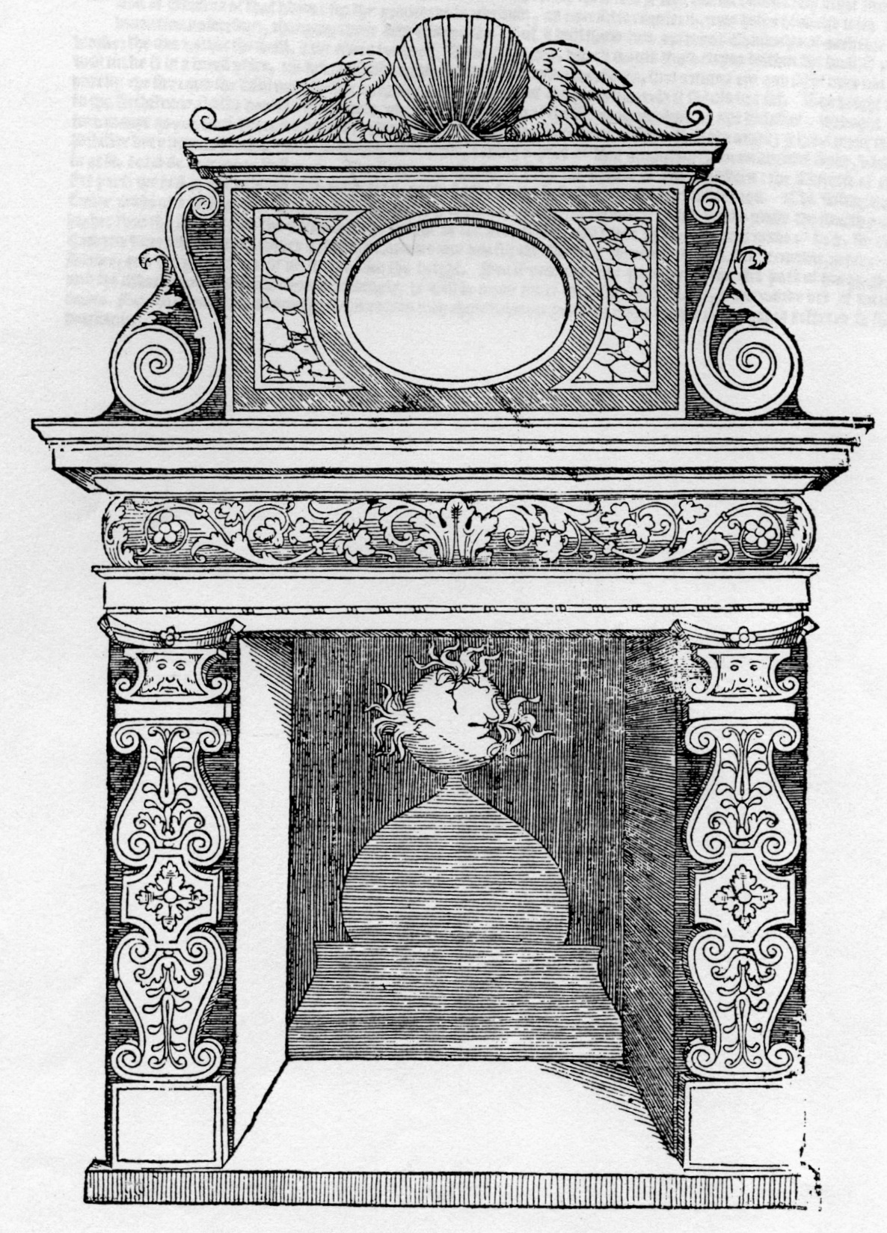
Sebastiano Serlio, Fireplace, Book IV: On Five Styles of Buildings, Venice, 1537, fol. 63v

Slide 54
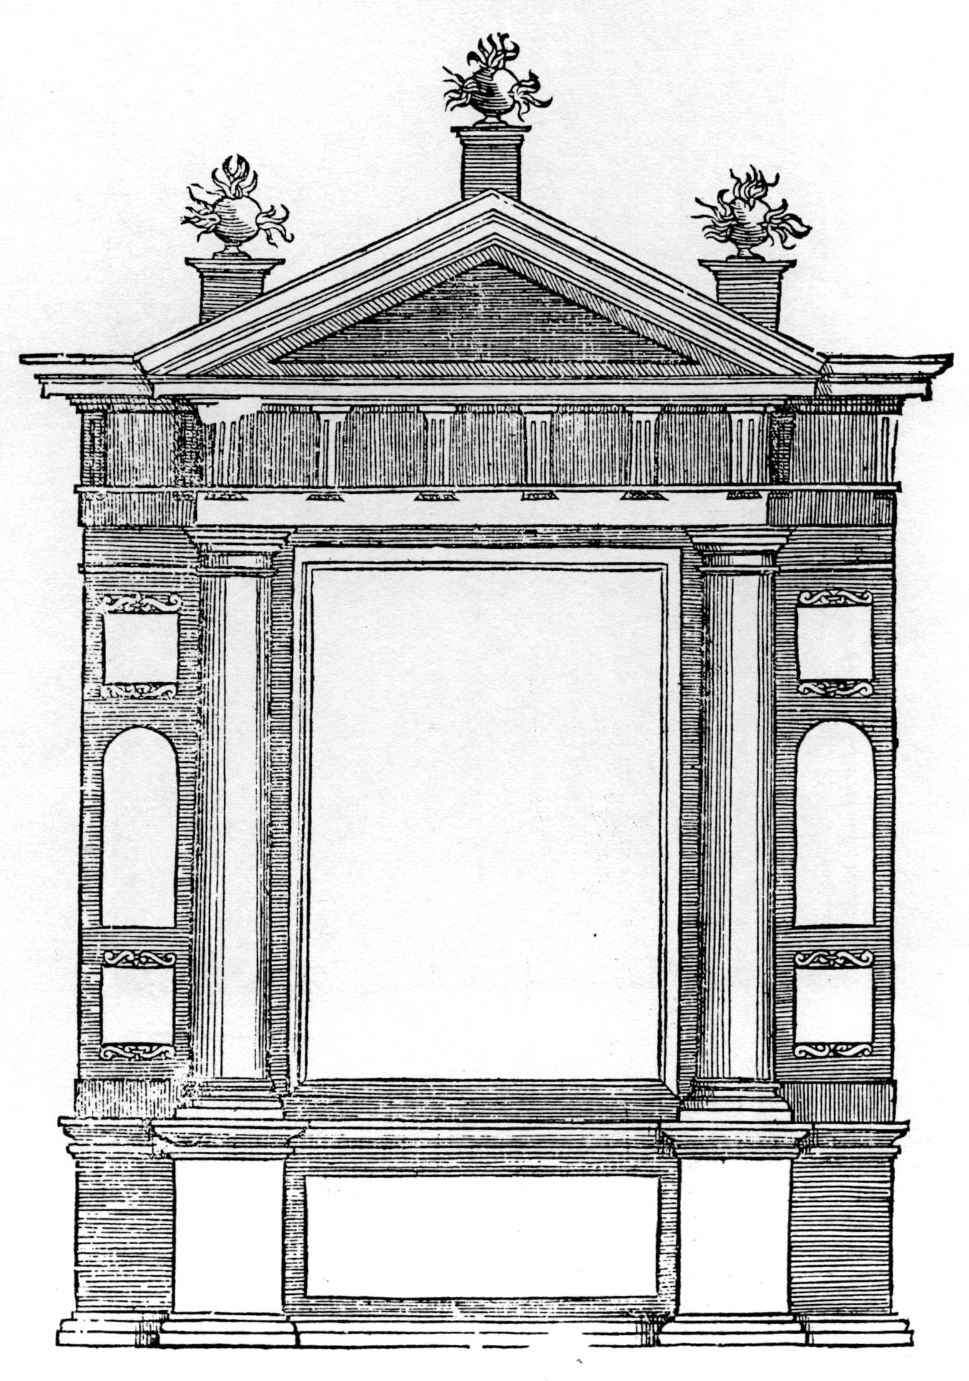
Sebastiano Serlio, Architectonic Frame, Book IV: On Five Styles of Buildings, Venice, 1537, fol. 28r

Slide 55
Kazimierz (Cracow), Isaac’s Synagogue. Bimah.

Slide 56
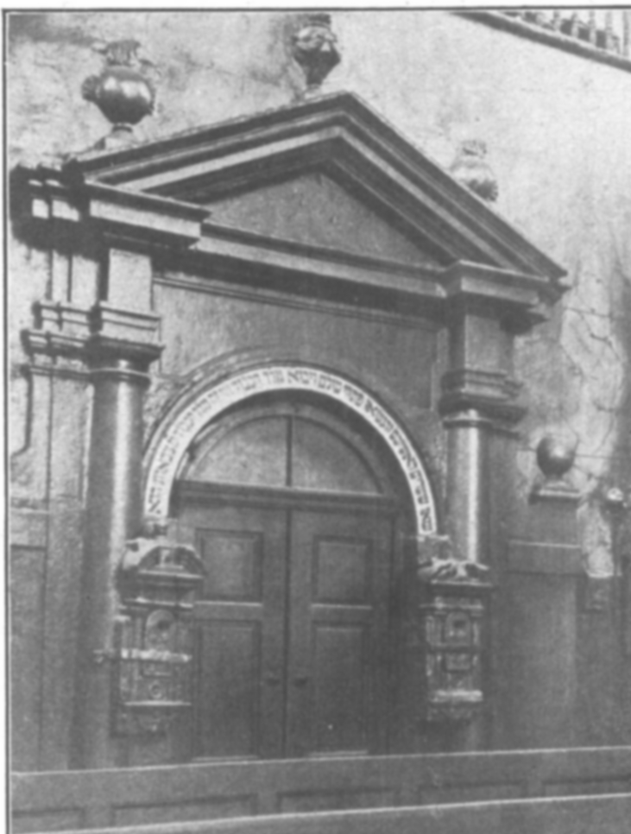
Kazimierz (Cracow), Isaac’s Synagogue. Portal.
Alfred Grotte, Drawings of the Isaac Synagogue

Slide 57
Мини-цикл: Изображение и воображение
Запечатлеть неуловимое: символы огня и света в ашкеназских синагогах
Илья Родов
Notes:
57

