Slide 1
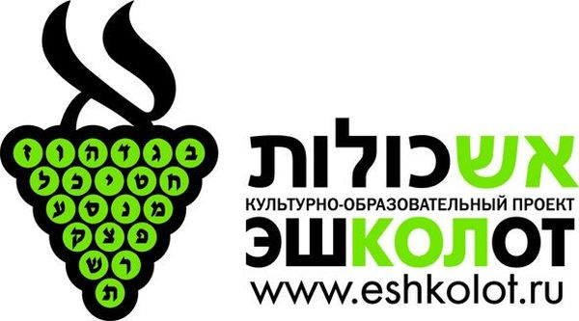
One Word, Two Parents
Phono-Semantic Matching in Israeli
(as well as in Mandarin Chinese, Japanese, Revolutionized Turkish, Icelandic, Arabic and Creoles)
Prof. Ghil‘ad Zuckermann (Гилад Цукерман) D.Phil. (Oxon.), Ph.D. (Cantab., titular)
Chair of Linguistics & Endangered Languages, The University of Adelaide
www.facebook.com/ProfessorZuckermann
www.zuckermann.org ghilad.zuckermann@adelaide.edu.au
Moscow, 14 November 2018

Slide 2
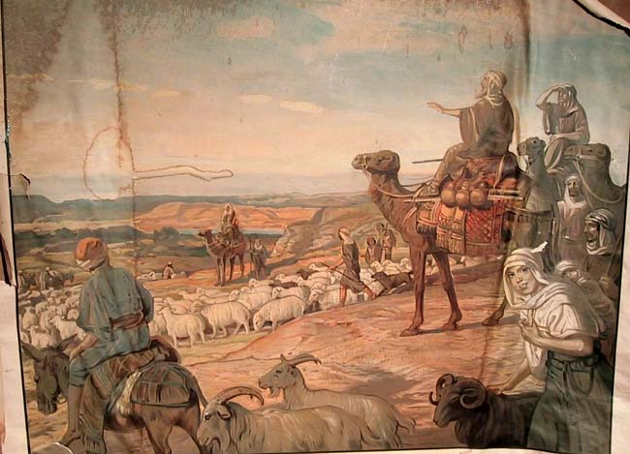
Professor Ghil‘ad Zuckermann 诸葛漫
DPhil (Oxford), PhD (Cambridge, titular)
Chair of Linguistics & Endangered Languages
The University of Adelaide
ghilad.zuckermann@adelaide.edu.au
www.adelaide.edu.au/directory/ghilad.zuckermann
www.facebook.com/ProfessorZuckermann
Professor Ghil‘ad Zuckermann

Slide 3
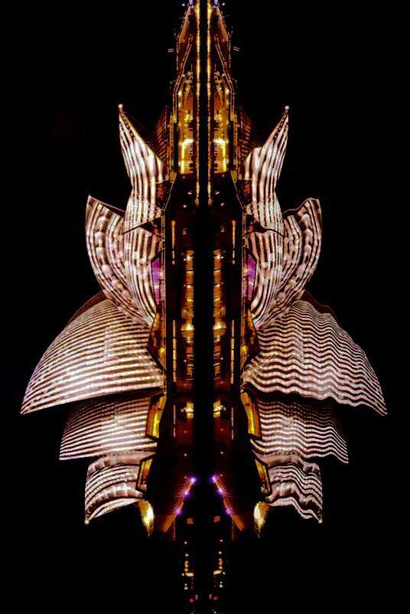
Professor Ghil‘ad Zuckermann

Slide 4
Abstract of Today’s Lecture-slash-discussion
Phono-semantic matching (PSM) is a technique by which a foreign word is reproduced in the target language, using pre-existing native elements that are similar to the foreign word both in meaning and in sound. Thus, the English word DUBBING was transformed into Israeli (Reclaimed Hebrew) as דיבוב DIBÚV, adding a new sense to the pre-existent Hebrew דבוב DIBBUV 'speech', the latter being a word that is etymologically unrelated to DUBBING but which serendipitously has a similar meaning and sound. Such multi-sourced neologization is an ideal means of lexical expansion because it conceals foreign influence from the future native speakers, ensures lexicographic acceptability of the coinage, recycles obsolete autochthonous roots and words (a delight for purists), and facilitates initial learning among contemporary learners and speakers.
This paper-slash-discussion will introduce PSM in (1) reclaimed (e.g. Revived Hebrew, henceforth Israeli), revolutionized (e.g. Republican Turkish) and puristically-oriented (e.g. Icelandic) languages, in which language-planners attempt to replace undesirable foreignisms or loanwords; and (2) languages using a phono-logographic script that does not allow mere phonetic adaptation, e.g. Chinese and Japanese (the latter only to the extent that kanji are used).
Traditional classifications of borrowing, e.g. Einar Haugen's, ignore such cross-fertilizations and categorize borrowing into either substitution or importation. However, PSM is a distinct phenomenon, which operates through simultaneous substitution and importation. Yet, PSM ought not to be confused with calquing as the latter lacks the phonetic matching component. Recognizing PSM carries significant implications of hybridity and multiple causation not only for lexicology and comparative historical linguistics, but also for sociolinguistics, cultural studies and Revivalistics.
Professor Ghil‘ad Zuckermann

Slide 5
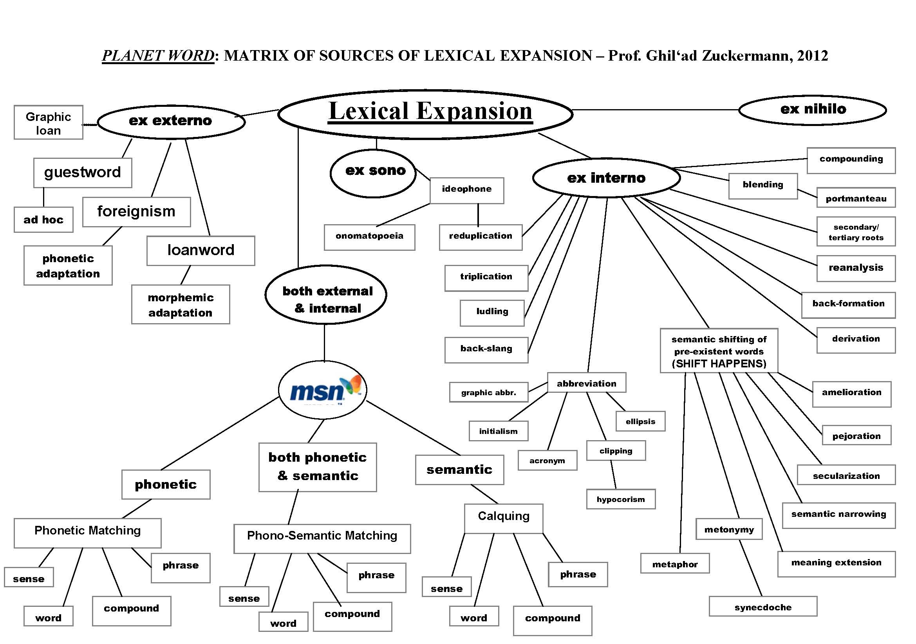

Slide 6
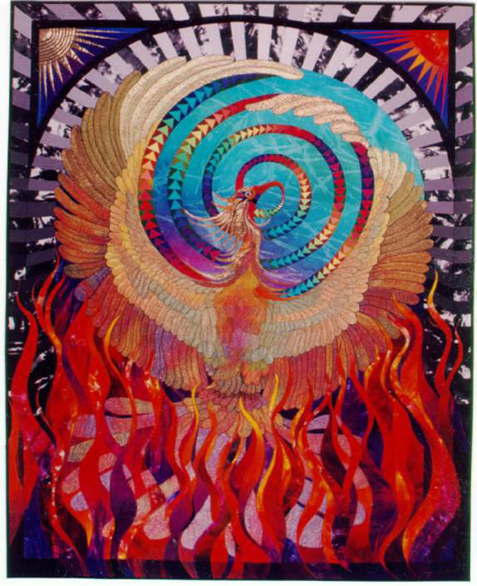
INTRODUCTION
Chaim Leyb Hazan, 27 April 1890, Hatsfirá ‘The Dawn’, p. 4:
The glass tool, which we put in front of our eyes in order to see well (очки, okulary, Brille), which has been given many different names: כלי מחזה kli makhazé [‘tool of vision’], כלי ראות kli reút, כלי ראי kli rói [‘seeing tool’], בתי עינים batéy eynáim [‘houses of eyes’], I propose to call משקפים mishkafáim. No one will deny that a one-word name is better than a multiple-word name.
…I chose it because of its similarity to the Greek word skopέw (‘I look at’), which appears in the names of all glass lenses in the languages of Europe: telescope, microscope, kaleidoscope and the like.
Professor Ghil‘ad Zuckermann

Slide 7
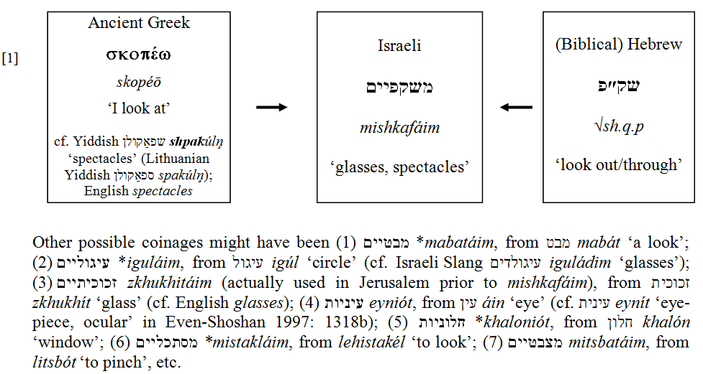
Professor Ghil‘ad Zuckermann

Slide 8
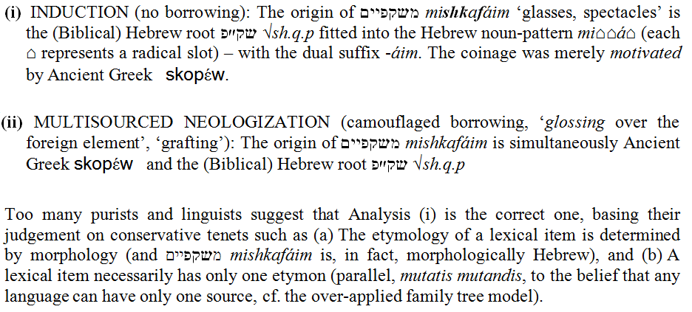
TWO POSSIBLE ETYMOLOGICAL ANALYSES
Professor Ghil‘ad Zuckermann

Slide 9
However, such one-dimensional, strictly structural, conservative views, just like the traditional classifications of sources of lexical enrichment (e.g. Haugen 1950), fail to take into account the intricate effects of language contact and linguistic diffusion. I would advocate a broader-based, structural cum motivational approach, one that considers the lexeme’s covert cultural, social and semantic aspects to be as important as its morphology, integrating lexical diffusion and genetic inheritance models.
Professor Ghil‘ad Zuckermann

Slide 10
‘PHONO-SEMANTIC MATCHING’ (PSM)
Professor Ghil‘ad Zuckermann

Slide 11
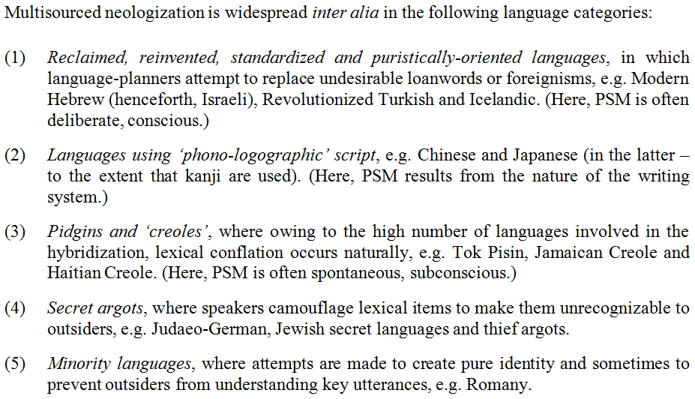
Professor Ghil‘ad Zuckermann

Slide 12
Professor Ghil‘ad Zuckermann

Slide 13
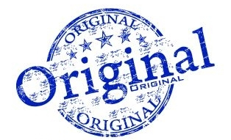
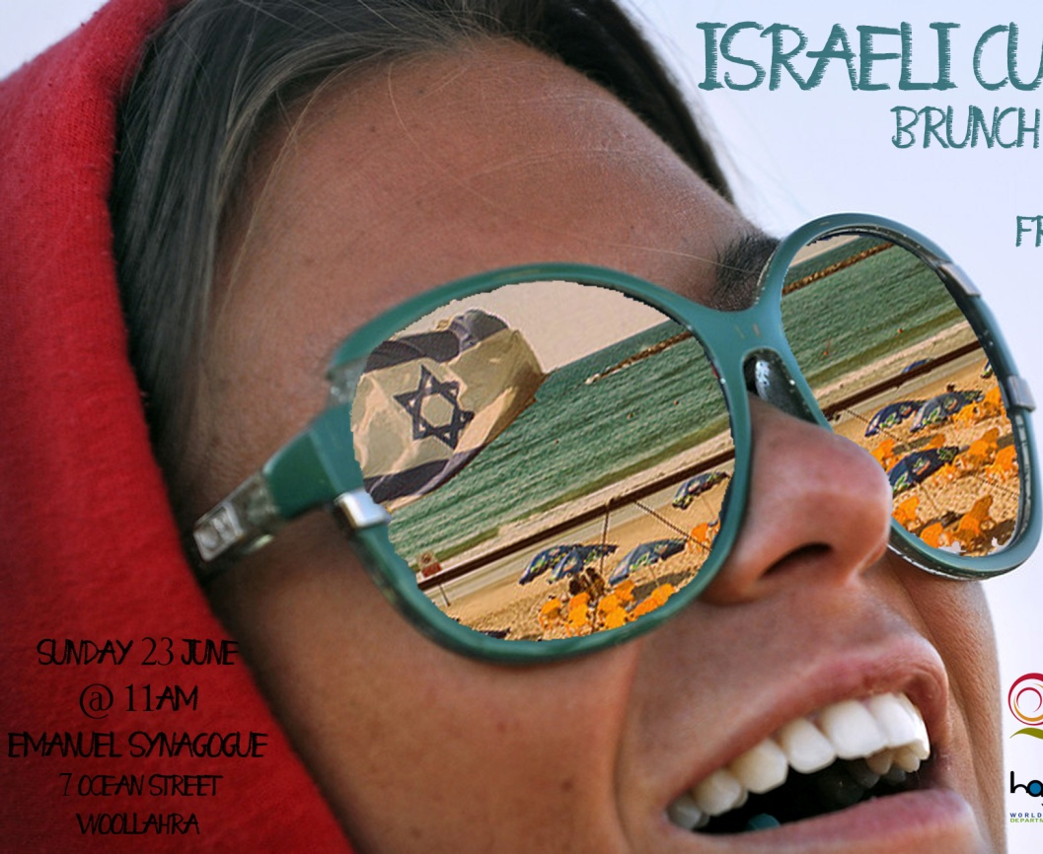
ISRAELI
Professor Ghil‘ad Zuckermann

Slide 14
Although language is, in fact, an abstract ensemble of idiolects, dialects, sociolects, ethnolects, aetolects etc., linguists try to generalize about the origins of languages. Indeed, the genetic classification of Israeli Hebrew, the language which emerged in Palestine at the end of the nineteenth century, has preoccupied linguists since its genesis. The still prevalent, traditional THESIS suggests that Israeli is Semitic: (Biblical/Mishnaic) Hebrew REVIVED.
Professor Ghil‘ad Zuckermann

Slide 15
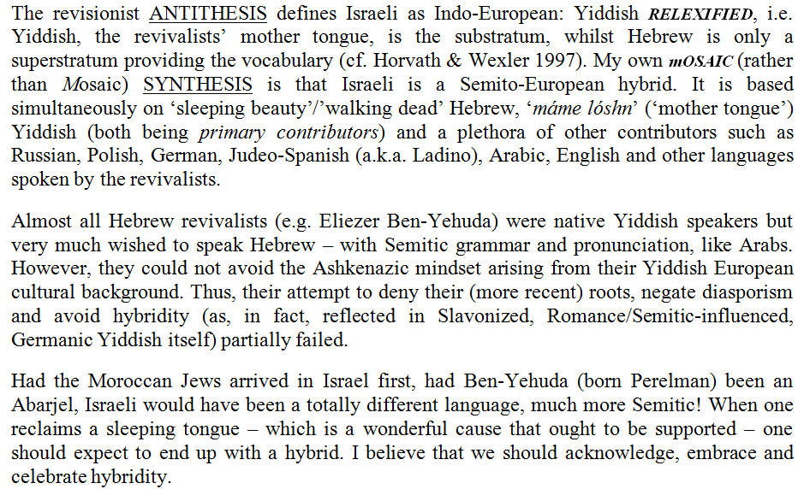
Professor Ghil‘ad Zuckermann

Slide 16
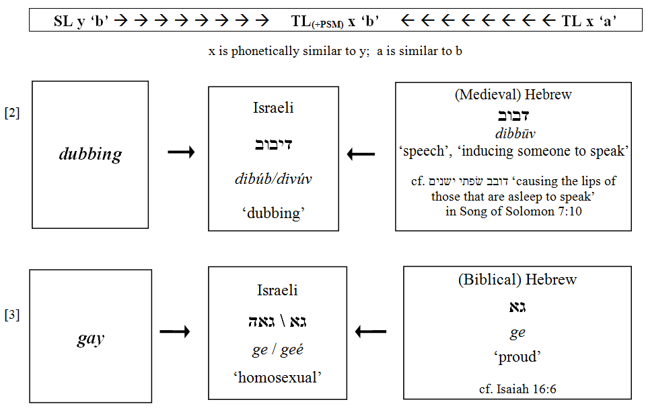
I. PSM that introduces a new SENSE
PSM produced by shifting the meaning of a pre-existent word in the target-language (TL).
Professor Ghil‘ad Zuckermann

Slide 17
Israeli גאה geé ‘homosexual’, a ‘politically correct PSM’, overrode Israeli עליז alíz ‘homosexual’, which originally meant ‘gay (merry, cheerful)’ and thus constituted a calque (loan-translation) of English gay. Note the semantic connection of the literal meaning of גאה ‘proud’ to the use of English gay pride to imply an empowered homosexual community – cf. gay pride parade
( Israeli מצעד הגאווה mitsád hagaavá ).
cf. the politically incorrect Yiddish pun found near a gay cemetery in San Francisco: גיי אין דר'ערד gey in drérd, lit. ‘Go to earth!’, meaning ‘Go to hell!’, reinterpreted as ‘gay in earth’.
Professor Ghil‘ad Zuckermann

Slide 18
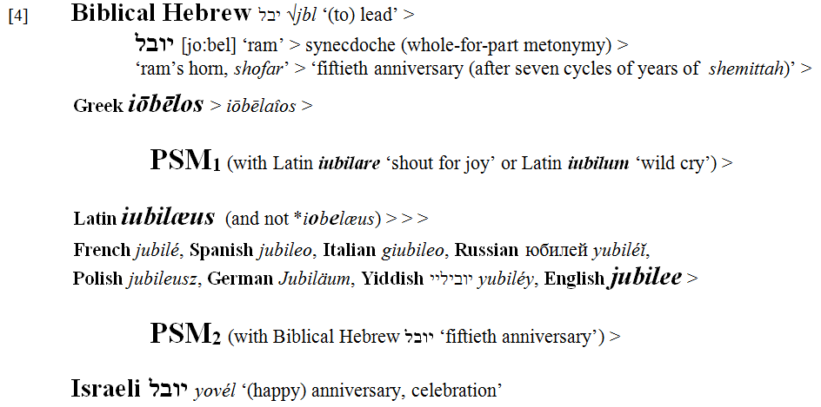
‘Incestuous PSM’
Professor Ghil‘ad Zuckermann

Slide 19
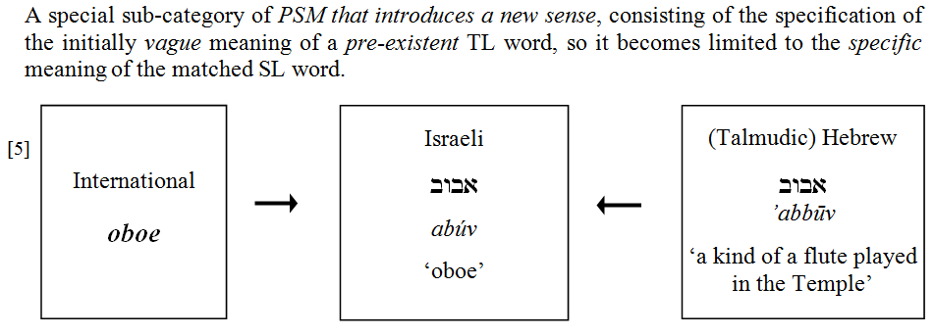
Specificizing PSM
Professor Ghil‘ad Zuckermann

Slide 20
II. PSM that introduces a new WORD
Professor Ghil‘ad Zuckermann

Slide 21
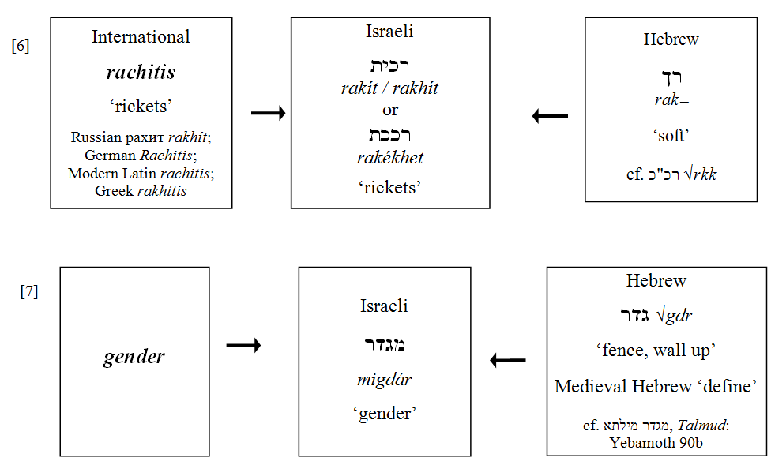
Professor Ghil‘ad Zuckermann

Slide 22
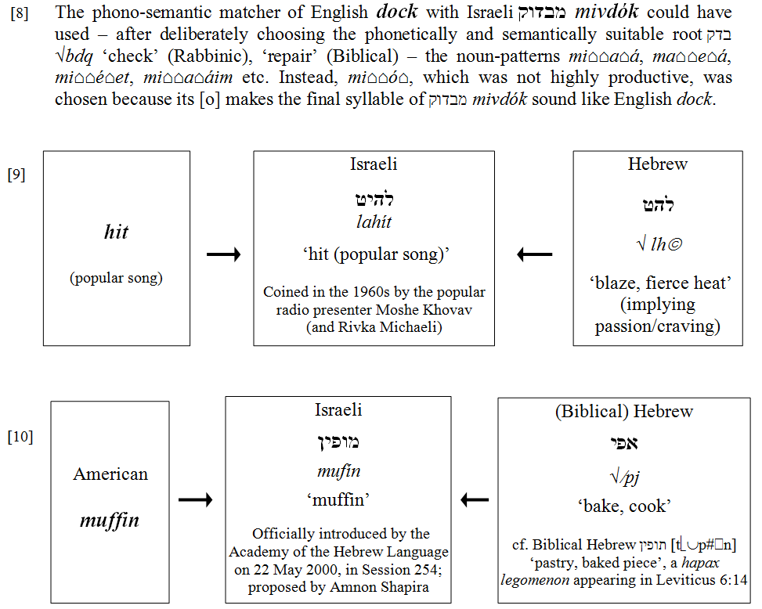
Often in PSM, the source-language not only dictates the choice of root, but also the choice of noun-pattern, thus constituting a camouflaged influence on the target-language morphology:
Professor Ghil‘ad Zuckermann

Slide 23
The Advantages of PSM for the (Puristic) Language Planner
recycling obsolete lexical items
camouflaging foreign influence (for the native speaker in the future)
facilitating initial learning (mnemonics) (for the contemporary learner/speaker)
Professor Ghil‘ad Zuckermann

Slide 24
Other Motivations for PSM
playfulness (cf. midrashic tradition of homiletic commentary; pilpul)
Apollonianism (the wish to create order/meaningfulness, cf. popular etymology, paronymic attraction)
iconicity (the belief that there is something intrinsic about the sound of names)
political correctness / rejective lexical engineering
attracting customers (in the case of brand names)
Professor Ghil‘ad Zuckermann

Slide 25
TURKISH
I know most of the dialects of the Asian Turks. I also understand the dialect spoken by people like you and Yakup Kadri. If there’s one dialect I can’t make head or tail of, it’s the dialect of the Turkish Language Society.
(Abdu lkadir to Atay in the 1930s, cf. Atay 1969: 478)
Professor Ghil‘ad Zuckermann

Slide 26
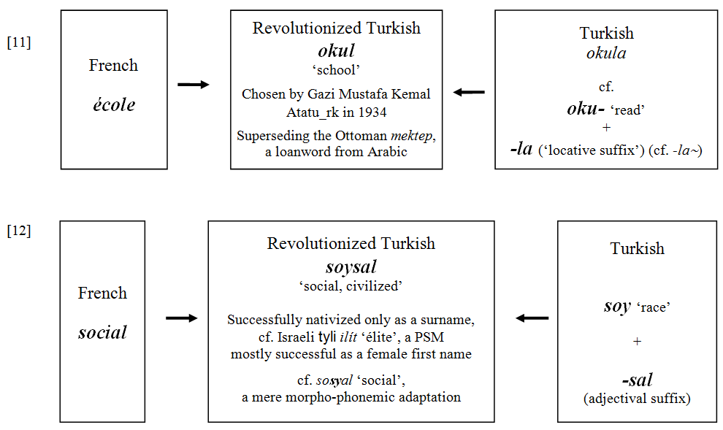
Professor Ghil‘ad Zuckermann

Slide 27
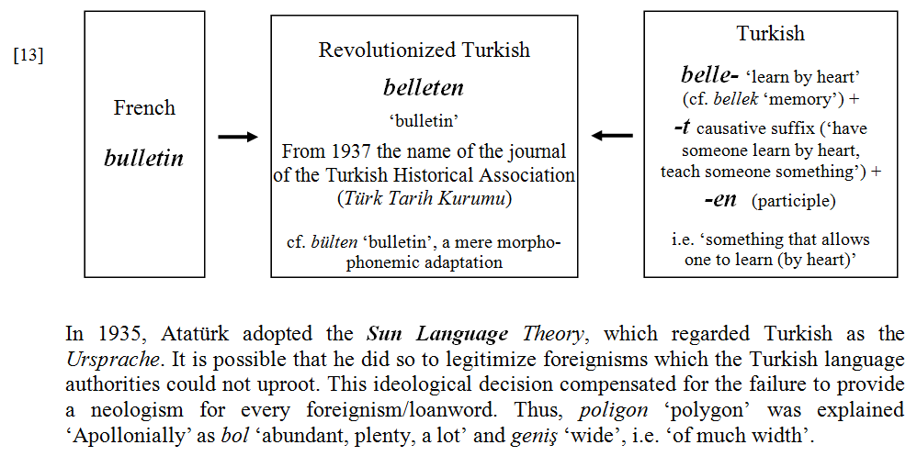
Professor Ghil‘ad Zuckermann

Slide 28
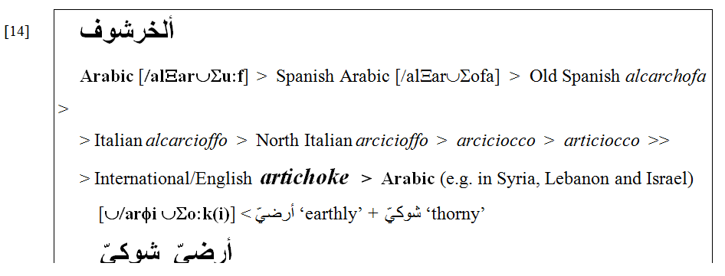
ARABIC
I hate artichokes but love their etymology.
Professor Ghil‘ad Zuckermann

Slide 29
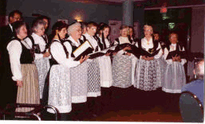
ICELANDIC
Icelandic is a Scandinavian (i.e. North Germanic) language spoken by more than 300,000 people. It emerged from the Old West Scandinavian dialects brought to Iceland with the chiefly Norwegian settlers between 870 and 930 AD. Due to centuries of Danish rule, it has not only become highly influenced by the Danish language, but according to reports from the mid-18th to mid-19th centuries, the language in the harbours and in the capital Reykjavik was a mixed Dano-Icelandic variety (Ottósson 1990: 29–52).
Growing interest in Old Icelandic manuscripts and an increasing national awakening gave rise to calls for the preservation of the language and to its ‘cleansing’ from foreign elements. In 1780 a declaration of a puristically-oriented language policy was formulated by the Icelandic Society for Learned Arts (Hið íslenska lærdómslistafélag), a group of Icelandic students in Copenhagen.
Professor Ghil‘ad Zuckermann

Slide 30
Through Iceland’s political sovereignty in 1918, full independence in 1944 and the establishment of the Icelandic Language Council (Íslensk málnefnd) in 1964, the status of Icelandic has been reinforced and language planning has ever since been carried out through legislation. The Council activities are run on a daily basis by its secretariat, Íslensk málstöð (Icelandic Language Institute), founded in 1985. Thus, Icelandic is currently one of the most puristically-oriented languages.
Professor Ghil‘ad Zuckermann

Slide 31
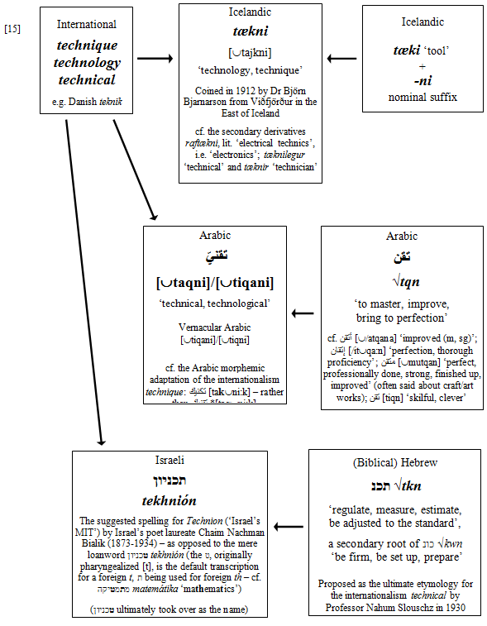
Professor Ghil‘ad Zuckermann

Slide 32
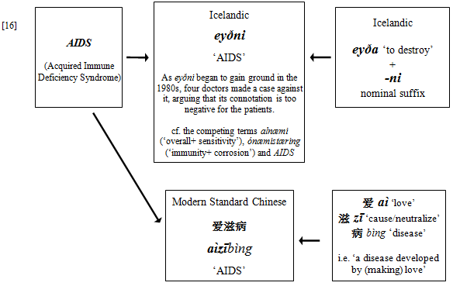
Professor Ghil‘ad Zuckermann

Slide 33
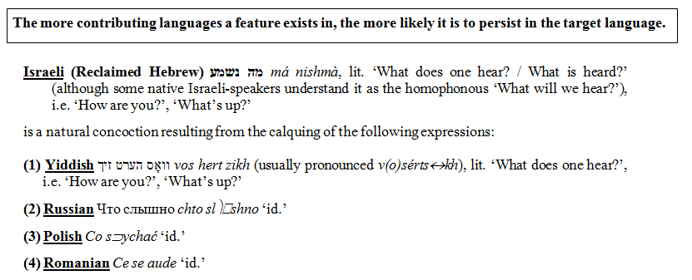
THE CONGRUENCE PRINCIPLE
Professor Ghil‘ad Zuckermann

Slide 34
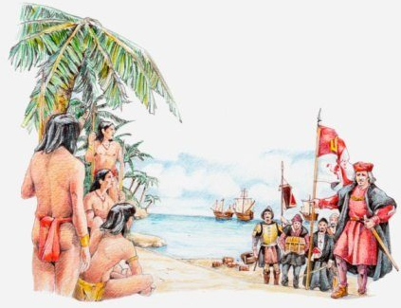
JAMAICAN CREOLE
Professor Ghil‘ad Zuckermann

Slide 35
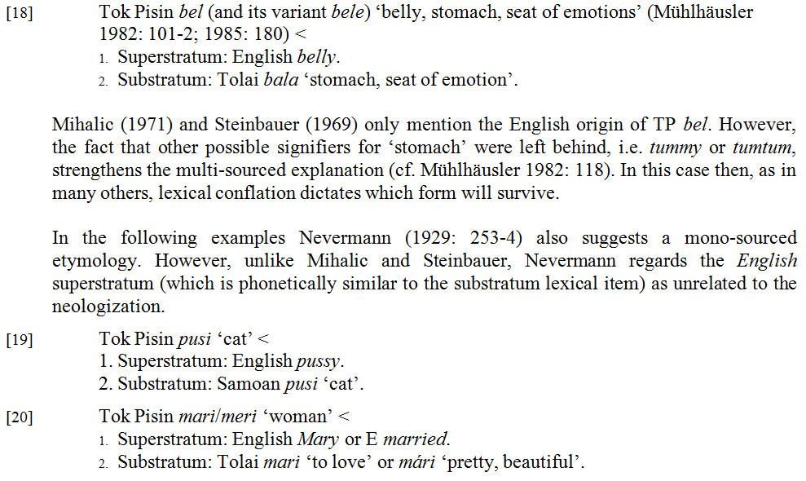
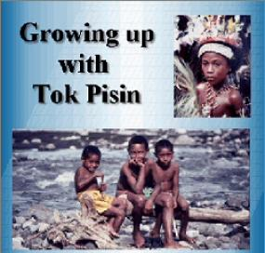
TOK PISIN
Professor Ghil‘ad Zuckermann

Slide 36
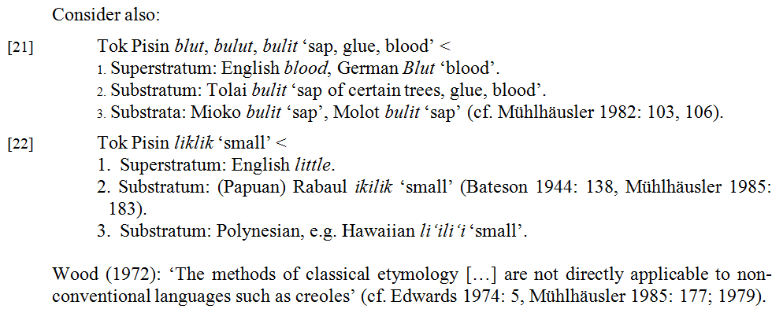
Professor Ghil‘ad Zuckermann

Slide 37
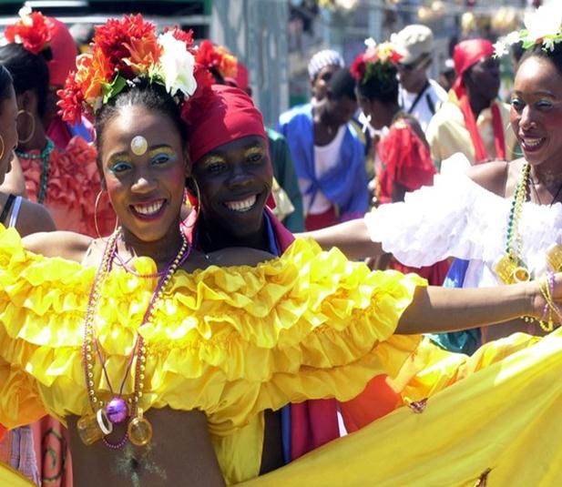
HAITIAN CREOLE
Professor Ghil‘ad Zuckermann

Slide 38
AUSTRALIAN ABORIGINAL TOPONYMS
Obviously, toponyms are a fertile ground for PSM.
Consider the South Australian place-name Noarlunga, which is not that far from Maslin Beach, the latter being the first nudist beach to achieve legal status in Australia (in 1975).
Geoffrey Manning, as well as Rodney Cockburn, argue that Noarlunga originally meant 'fishing place'.
Praite and Tolley, however, claim that the name originally meant 'the place with a hill',
from the Ramindjeri word ngurle 'hill' and
the Kaurna locative (place) suffix -ngka.
Professor Ghil‘ad Zuckermann

Slide 39
AUSTRALIAN ABORIGINAL TOPONYMS
However, the real etymon, the actual origin, is more likely to be the Kaurna word nurlu 'corner’, followed by the Kaurna locative (place) suffix -ngka, resulting in Nurlungka,
which literally means ‘on the river bend’,
referring to the Horseshoe Bend on the Onkaparinga River,
where the Noarlunga town was founded.
Professor Ghil‘ad Zuckermann

Slide 40
AUSTRALIAN ABORIGINAL TOPONYMS
Sometimes a place-name that looks completely English is, in reality, a camouflaged, concealed, hidden, Aboriginal name.
Consider the beautiful Adelaide Hills town of Piccadilly. The original name was in the Kaurna Aboriginal language: pikurdla, which literally meant ‘two eyebrows’, from piku ‘eyebrow’ and the dual suffix -rdla.
Professor Ghil‘ad Zuckermann

Slide 41
AUSTRALIAN ABORIGINAL TOPONYMS
The very same Kaurna dual suffix appears in another Adelaide Hills place-name: Uraidla refers in Kaurna to ‘two ears’, from yuri ‘ear’ and the dual suffix -rdla.
Professor Ghil‘ad Zuckermann

Slide 42
AUSTRALIAN ABORIGINAL TOPONYMS
And on the other hand, sometimes a place-name that looks Aboriginal is actually the Aboriginal pronunciation of an English word, after all. When I lived in Brisbane, I enjoyed travelling to Toowoomba.
Professor Ghil‘ad Zuckermann

Slide 43
AUSTRALIAN ABORIGINAL TOPONYMS
The name Toowoomba is the way that some Aboriginal people pronounced the English word swamp.
(Remember that Aboriginal languages usually do not have the S sound. Neither do they distinguish between voiced sounds like B/G/D; and voiceless sounds like P/K/T. Hence Toowoomba. Do not tell an Aboriginal person: You are a brick!, which is, of course, a compliment in England, referring to ‘a good, helpful and trustworthy fellow’.)
Professor Ghil‘ad Zuckermann

Slide 44
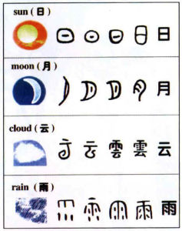
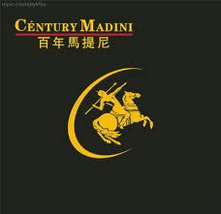
MANDARIN
MODERN STANDARD CHINESE (MAINLAND CHINA); ‘THE NATIONAL LANGUAGE’ (TAIWAN)
Ex oriente lux, ex occidente lex.
PSM in Mandarin is common in (1) brand names, (2) computer jargon, (3) technological terms, and (4) toponyms. From a puristic perspective, Mandarin PSM is the ‘lesser evil’. The worse option would have been roman orthography (in writing) or code switching (in speech).
Professor Ghil‘ad Zuckermann

Slide 45
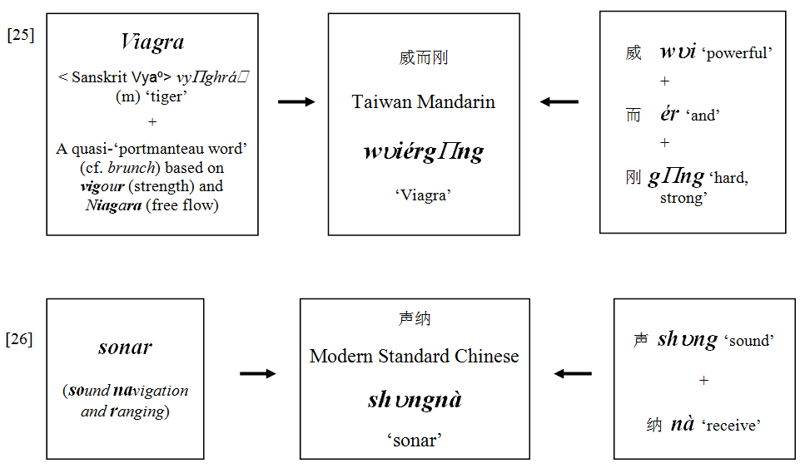
Professor Ghil‘ad Zuckermann

Slide 46
Professor Ghil‘ad Zuckermann

Slide 47
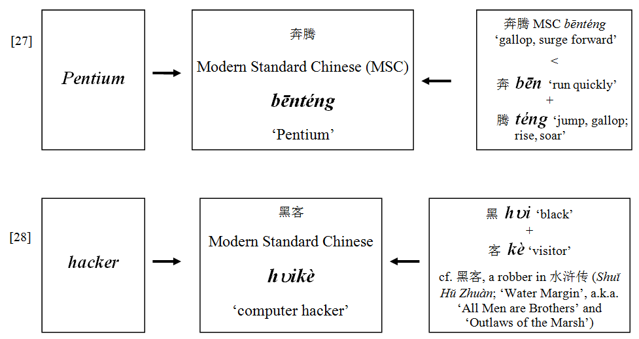
Professor Ghil‘ad Zuckermann

Slide 48
Professor Ghil‘ad Zuckermann

Slide 49
JAPANESE
Similia similibus curantur.
PSM in Japanese was popular in the fin-de-siècle Meiji Period (1868-1912). Currently, due to increased employment of the katakana syllabary (used for foreign words – like italics in English, mutatis mutandis), as well as to non-puristic, Americanophile attitude, it is not as common.
Professor Ghil‘ad Zuckermann

Slide 50
Professor Ghil‘ad Zuckermann

Slide 51
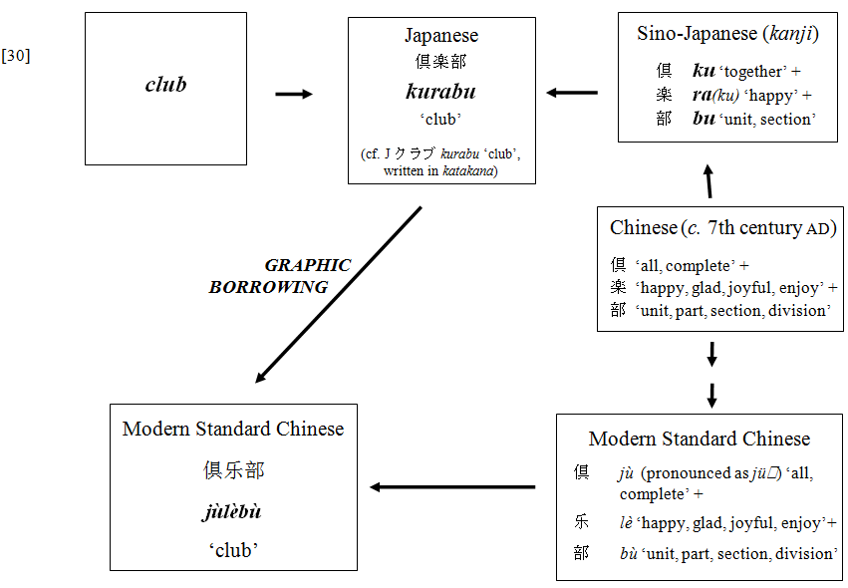
Professor Ghil‘ad Zuckermann

Slide 52
Professor Ghil‘ad Zuckermann 诸葛漫
DPhil (Oxford), PhD (Cambridge, titular)
Chair of Linguistics & Endangered Languages
The University of Adelaide
ghilad.zuckermann@adelaide.edu.au
www.adelaide.edu.au/directory/ghilad.zuckermann
www.facebook.com/ProfessorZuckermann
Professor Ghil‘ad Zuckermann

Slide 53
Main sources (including detailed discussion of theoretical and practical implications, polychronic analysis of 200 more PSMs, and full bibliographical references):
Sapir, Y. and Zuckermann, G. 2008. ‘Icelandic: Phonosemantic Matching’, pp. 19-43 (Chapter 2) of Judith Rosenhouse and Rotem Kowner (eds), Globally Speaking: Motives for Adopting English Vocabulary in Other Languages. Clevedon – Buffalo – Toronto: Multilingual Matters.
Zuckermann, G. 2003. Language Contact and Lexical Enrichment in Israeli Hebrew. London – New York: Palgrave Macmillan. [http://www.zuckermann.org/enrichment.html]
Zuckermann, G. 2003. ‘Language Contact and Globalisation: The Camouflaged Influence of English on the World’s Languages – with special attention to Israeli (sic) and Mandarin’. Cambridge Review of International Affairs 16.2: 287-307.
Zuckermann, G. 2004. ‘Cultural Hybridity: Multisourced Neologization in “Reinvented” Languages and in Languages with “Phono-Logographic” Script’. Languages in Contrast 4.2: 281-318.
Professor Ghil‘ad Zuckermann

Slide 54
On multiple causation and hybridity, see also
Yadin, A. and Zuckermann, G. 2010. ‘Blorít: Pagans’ Mohawk or Sabras’ Forelock?: Ideological Secularization of Hebrew Terms in Socialist Zionist Israeli’, pp. 84-125 (Chapter 6) of ‘Tope Omoniyi (ed.), The Sociology of Language and Religion: Change, Conflict and Accommodation. London – New York: Palgrave Macmillan.
Zuckermann, G. 2006. ‘A New Vision for Israeli Hebrew: Theoretical and Practical Implications of Analysing Israel's Main Language as a Semi-Engineered Semito-European Hybrid Language’. Journal of Modern Jewish Studies 5: 57-71.
Zuckermann, G. 2008. Israelít safá yafá (Israeli – A Beautiful Language). Tel Aviv: Am Oved. [http://www.zuckermann.org/israelit.html]
Zuckermann, G. 2008. ‘“Realistic Prescriptivism”: The Academy of the Hebrew Language, its Campaign of “Good Grammar” and Lexpionage, and the Native Israeli Speakers’. Israel Studies in Language and Society 1.1: 135-154.
Zuckermann, G. 2009. “Hybridity versus Revivability: Multiple Causation, Forms and Patterns”. Journal of Language Contact, Varia 2: 40-67.
Zuckermann, G. 2011. ‘Toponymy and Monopoly: One Toponym, Two Parents – Ideological Hebraization of Arabic Place Names in the Israeli Language’, Onoma 41.
Professor Ghil‘ad Zuckermann

Slide 55
Cont.
Zuckermann, G. 2011. “Hebrew Revivalists’ Goals vis-à-vis the Emerging Israeli Language” in Joshua A. Fishman and Ofelia García (eds), Success and Failure Continuum (Volume II of Handbook of Language and Ethnic Identity), Oxford University Press.
Zuckermann, Ghil‘ad & Walsh, Michael 2011."Stop, Revive, Survive!: Lessons from the Hebrew Revival Applicable to the Reclamation, Maintenance and Empowerment of Aboriginal Languages and Cultures". Australian Journal of Linguistics 31: 111-127. http://www.zuckermann.org/pdf/Revival_Linguistics.pdf
Also published as Chapter 28 of Making Sense of Language Readings in Culture and Communication (2012), Second Edition, edited by Susan D. Blum
Zuckermann, Ghil‘ad, Shiori Shakuto-Neoh and Giovanni Matteo Quer 2014. ‘Native Tongue Title: Proposed Compensation for the Loss of Aboriginal Languages’, Australian Aboriginal Studies (AAS) 2014/1: 55-71. http://www.professorzuckermann.com/#!native-tongue-title/cufd
Zuckermann, Ghil‘ad & Walsh, Michael 2014. ‘“Our Ancestors Are Happy!”: Revivalistics in the Service of Indigenous Wellbeing’, pp. 113-119 of Foundation for Endangered Languages XVIII. Naha, Ryukyuan Island, Okinawa, Japan. http://www.professorzuckermann.com/#!our-ancestors-are-happy-/c1bgt
Professor Ghil‘ad Zuckermann

Slide 56
Professor Ghil‘ad Zuckermann 诸葛漫
DPhil (Oxford), PhD (Cambridge, titular)
Chair of Linguistics & Endangered Languages
The University of Adelaide
ghilad.zuckermann@adelaide.edu.au
www.adelaide.edu.au/directory/ghilad.zuckermann
www.facebook.com/ProfessorZuckermann
Professor Ghil‘ad Zuckermann

Slide 57
QUESTIONS
Should revival languages use PSM?
Do you have examples of PSM in your own languages?
Professor Ghil‘ad Zuckermann

Slide 58
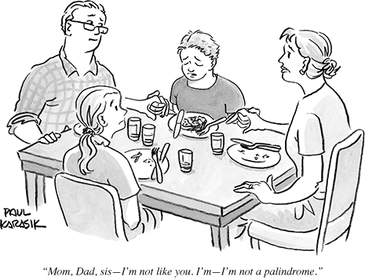
Stressed? GLENELG Desserts!
Professor Ghil‘ad Zuckermann

Slide 59
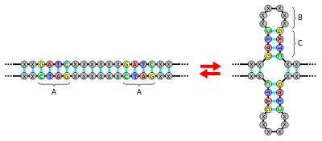
Palindromes
Professor Ghil‘ad Zuckermann

Slide 60
הִפּוכופּה = ריצת ציר
שם, היא לקחה לשון ורדים וחולדה טרפה תולעת. לא נגרם אסון צורף וסבל. בַּרחוב, צועני בְּשֵם מתוּשלח דחף בְּחרוּף נפש רופא לבוּש צְחוֹרים. ברור וחשוב לציֵן: הבחור, השוכר דירות ברחוב פִּינֵס, זכר סוֹד רמאים והלך לדוּג בְּים הזּרמים הרמים. הזרמים נָטְרוּ סוּג פֶּלֶג לפוֹעלוֹ. נוצר בּוֹ המוּזר בתוך היּם.
זמר להקה עמד ושאב רוחות מפּרְשן שבוי. האיש בלט והפיח נועם בקורס הכנה לבחן בספורט.
איבה נוצרה והרצון הביא טֵרוּף. סב נח בּלֶה נכֵה סרוּק במעון חיפה וטל בשיא היוֹבש נשרף מתוח ורב אש ודמע.
הקהל רמז מי הכּוֹתֵב רֵזוּמֵה וברצונו לעוף לגלפּגוֹס, ורטן: מי מרזה? מי מרה מִיּם רזה? מי בּגוּד לכלה? ומי אמר: "דוֹס רכּז סְנִיף בּוֹחֵר בְּתוֹר יד רכוש"? הרוחב הניצל בו שחור ורב.
מי רוחץ שובל אפור? שפן פורח בפחד, חלש ותם משבי, נעוץ בּוֹ חרב.
לבסוף: רוּץ, נוּס, אמרגן, אל תעלות הפרט הדלוח ומידרונו של החקלאי המּש.
Professor Ghil‘ad Zuckermann

Slide 61
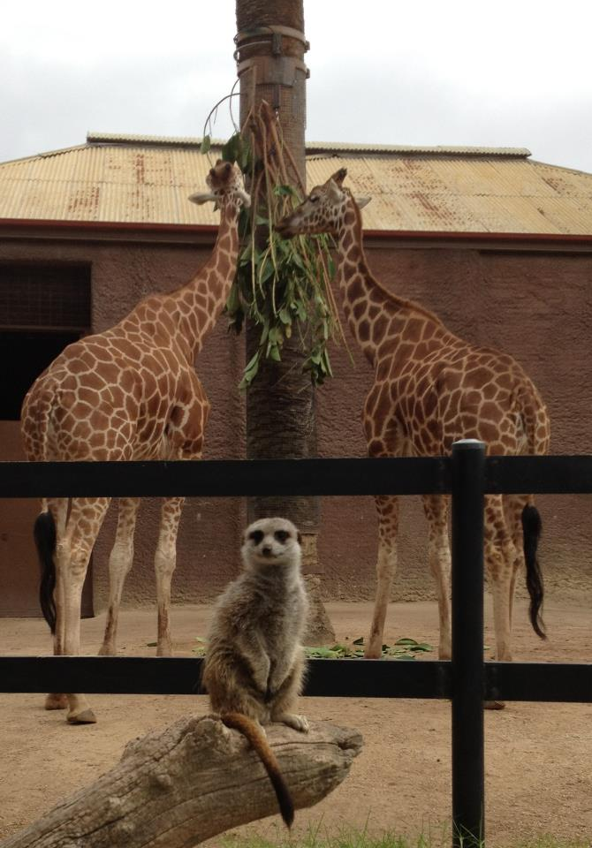
Professor Ghil‘ad Zuckermann

