Slide 1
Из истории алфавита
Язык протосинайской письменности

Slide 2
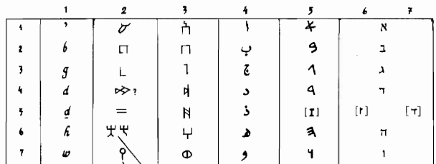
Некоторые семитские алфавиты

Slide 3
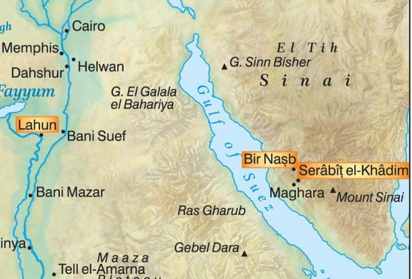
Египет, Синай, Серабит аль-Хадим

Slide 4
Дешифровки протосинайского письма
Gardiner, Alan H. The Egyptian Origin of the Semitic Alphabet” Journal of Egyptian Archaeology 3 (1916) 1-16
Albright, W. F. The Proto-Sinaitic Inscriptions and Their Decipherment (Harvard Theological Studies 22). Cambridge, 1966.
Sass, B. The Genesis of the Alphabet and Its Development in the Second Millennium BC, AAT 13. Wiesbaden, 1988.
Лундин А.Г. Дешифровка протосинайского письма. М. Наука 1991.

Slide 5
Гипотеза Дугласа Петровича (Wilfried Laurier University, Waterloo, Canada)
Petrovich D. The World's Oldest Alphabet: Hebrew as the Language
of the Proto-Consonantal Script. Jerusalem, 2016.
Bower B. Oldest alphabet identified as Hebrew //
Science News, 19.11.2016 >>
Petrovich D. Hebrew as the Language behind the World’s First
Alphabet? // The Ancient Near East Today V.4 (April 2017) >>

Slide 6
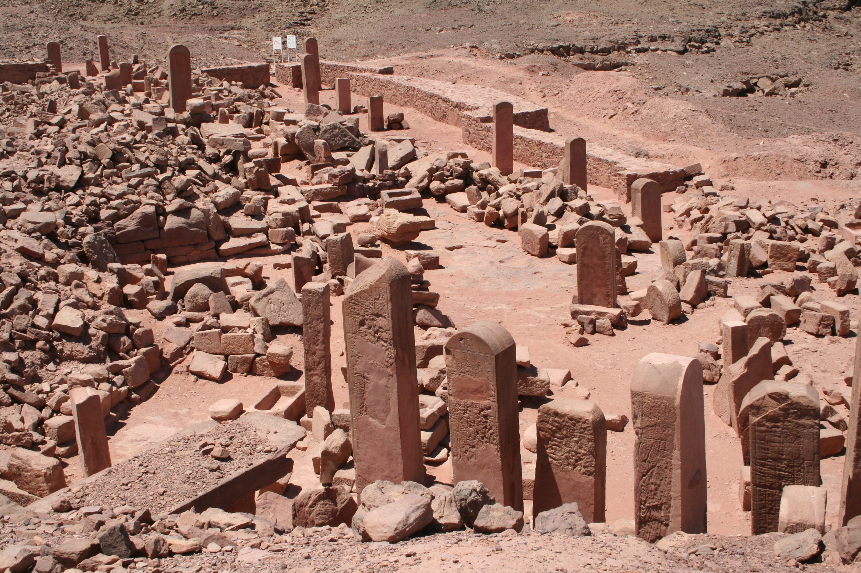
Серабит аль Хадим

Slide 7
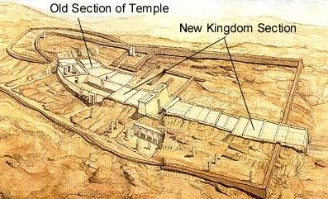
Храм Хатхор в Серабит аль Хадим

Slide 8
Синайские (набатейские) надписи (Sanchez 2015)
šlm ʕmywv br ḥryšw khn ʕzyʔ

Slide 9
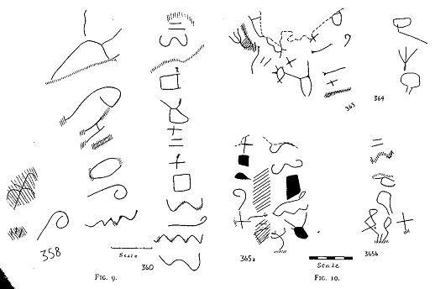
Протосинайские надписи (Albright 1966)

Slide 10
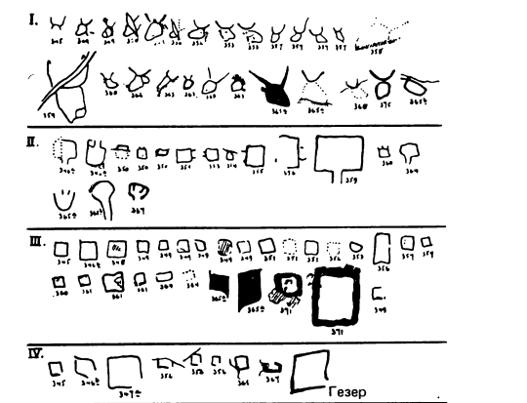
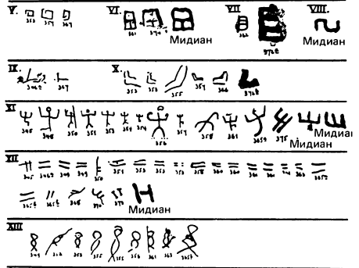
Идентификация знаков (Leibovitch 1934)

Slide 11
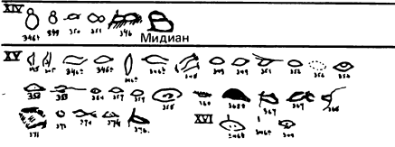
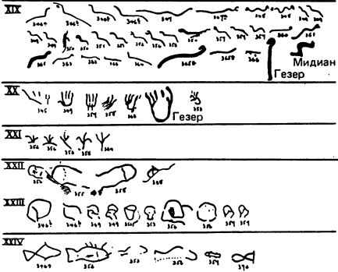
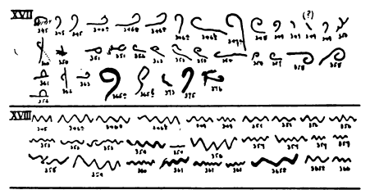
Идентификация знаков

Slide 12
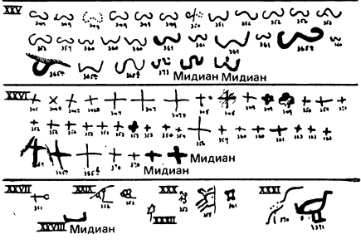
Идентификация знаков

Slide 13
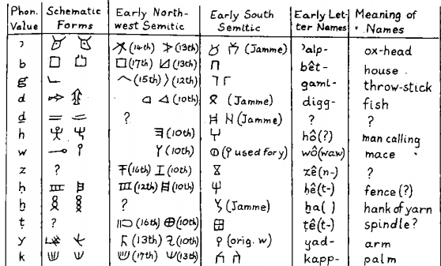
Реконструкция алфавита (Albright 1966)

Slide 14
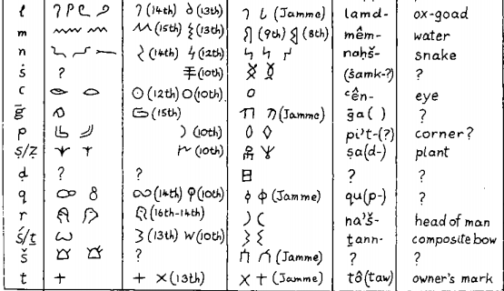
Реконструкция алфавита (продолжение)

Slide 15
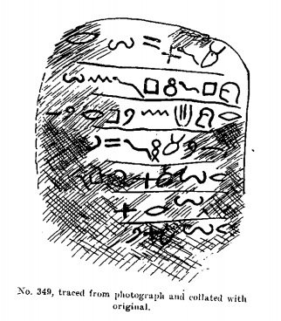
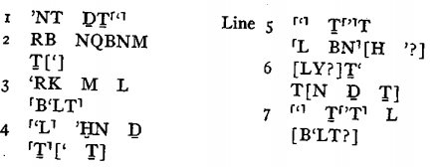
Интерпретация текстов (Albright 1966, Sinai 349)

Slide 16
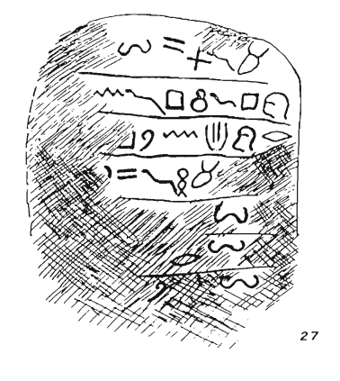
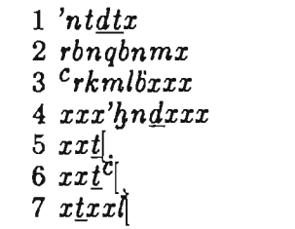
Sinai 349 (чтение Sass 1988)

Slide 17
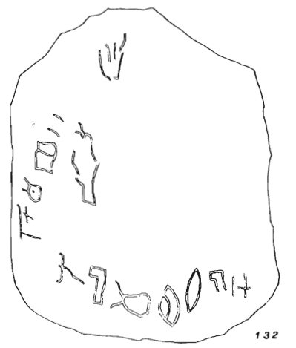
Sinai 375a (Sass 1988)
k

Slide 18
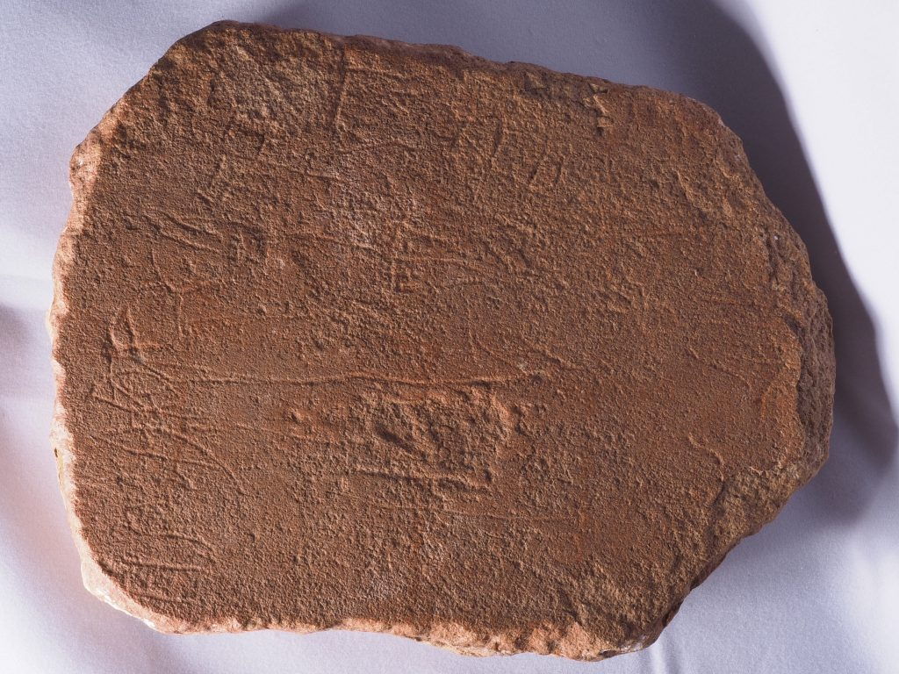
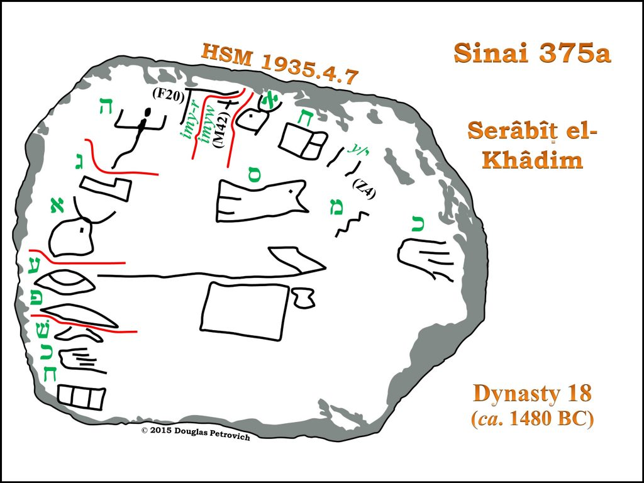
Sinai 375a (Petrovich 2017)

Slide 19
Sinai 375a (Petrovich 2016, 2017)
12.2016
A drawing of the slab’s inscriptions (right) shows early Hebrew letters next to corresponding modern Hebrew letters (green). Inscriptions along the left edge of the slab translate as “The one having been elevated is weary to forget.” Inscriptions across the top translate as “The overseer of minerals, Ahisemach*.”
04.2017
Sinai 375a designates Ahisamach with the office of Overseer of Minerals (?), probably signifying that he was responsible for the mineralogical work related to the acquisition of turquoise.
*Ahisamach Ex 31:6 etc.

Slide 20
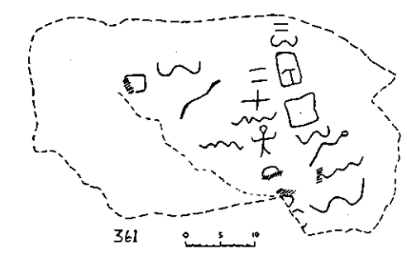
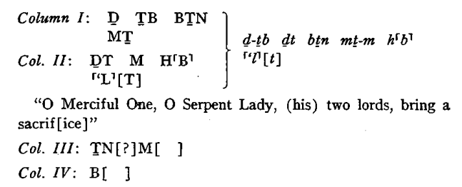
Sinai 361 (Albright 1966)

Slide 21
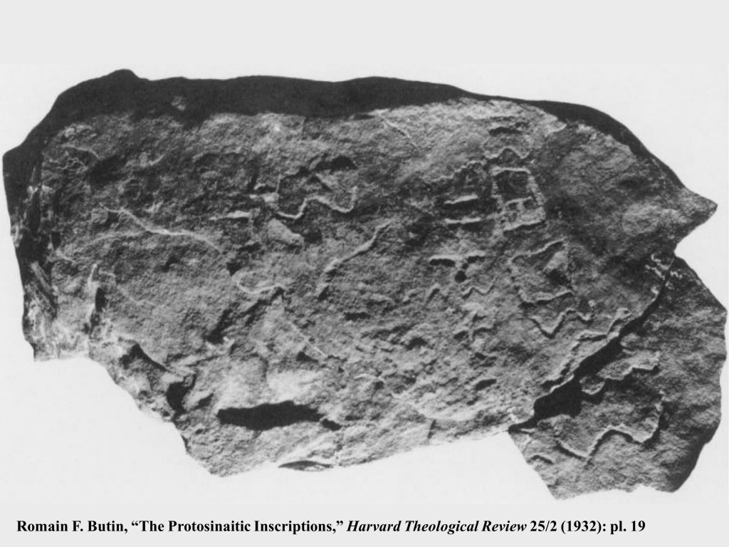
Sinai 361 (Butin 1932)

Slide 22
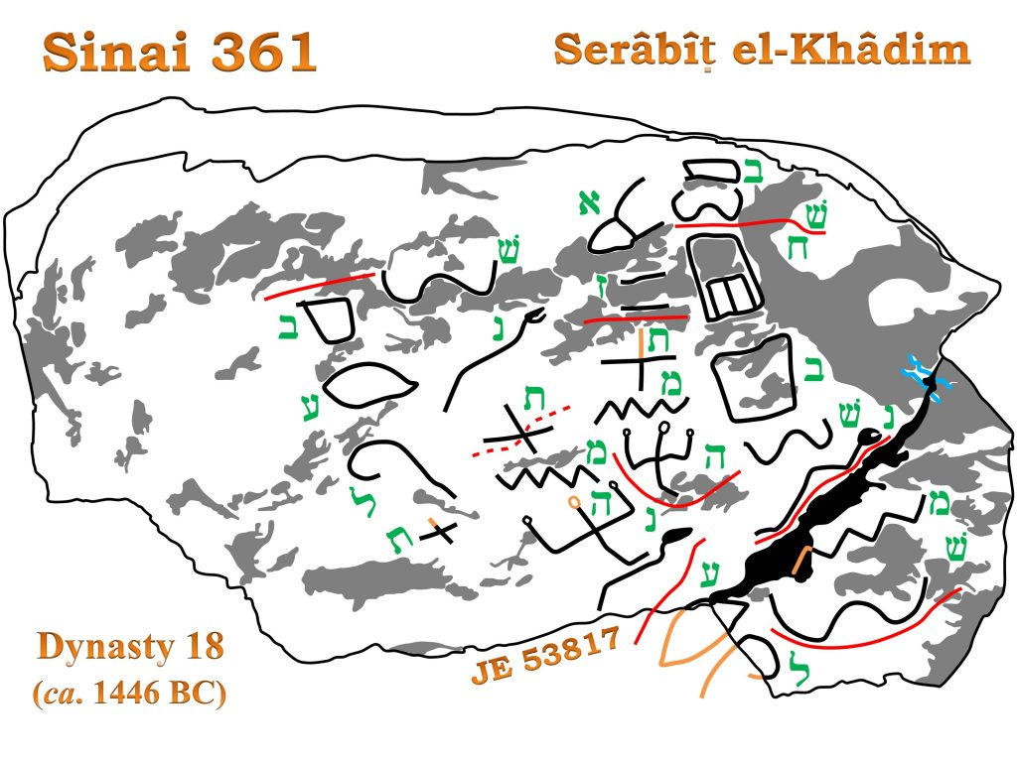
Sinai 361 (Petrovich 2017)
bš / ḥbšn / mš
ʔz / tmh
šnt / <t>mhn / ʕl
bʕlt
bš / ḥbšn / mš
ʔz / tmh
šnt / <t>mhn / ʕl
bʕlt
Notes:
bš / ḥbšn / mš
ʔz / tmh
šnt / <t>mhn / ʕl
bʕlt

Slide 23
Sinai 361 (Petrovich 2017)
Moses, who needs little or no explanation, is the man attributed with having led the Israelites out of Egyptian captivity (Exodus 12). The Hebrew author of Sinai 361 complained that their bound servitude had lingered, then stated that Moses—whose name appears in the emphatic position—then provoked astonishment, and that this was a year of astonishment, due to Baalath (the female consort of the storm-god deity, and who in Egypt was identified with Hathor).
bš ‘lingered’ cf. BH bwš II ‘to hesitate, to tarry’.

