Slide 1
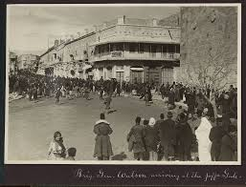
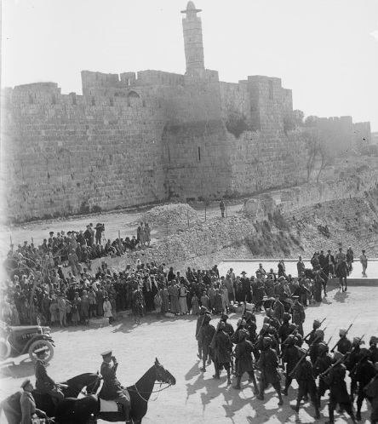
Transitions between Empires: Jerusalem between Ottoman and British Rule
Abigail Jacobson
The Hebrew University of Jerusalem

Slide 2
Jerusalem as an Inter-Imperial City

Slide 3
The transition moment between the Ottoman and British regimes as complex, ambivalent, and full of internal contradictions:
The British intention to rule Jerusalem, and eventually the entire country, without being seen as a colonial regime.
How did the British plan to occupy the city? How did they wanted the occupation to be perceived by the local population?
The moment of transition as full of symbolic interpretations.
The reactions of the local population, as well as of the British soldiers and military administration, to the occupation an the imperial shift in the country.

Slide 4
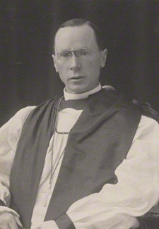
Bishop Rennie MacInnes
“…I would therefor urge that in all lands of which we become possessed, every building originally erected as a Christian church which is now used as a mosque or held by Muslim hands, be officially taken back into Christian possession.” (May 2, 1917)
TNA:PRO, FO 882/14, PA/17/7, 304-306

Slide 5
Colonel Graves to Colonel Deeds (October 15 1917):
“…Bishop MacInnes appears to regard our invasion of Palestine somewhat is the light of a crusade, the success of which should place Christianity in a predominant position over Islam and other confessions. At least, the carrying out of his proposals would undoubtedly have that effect upon the native mind. This is a natural enough attitude on the part of a Christian Bishop, but it does not take into account the questions of military and political expediency by which we must be guided. […]
it would be highly impolitic to allow this question to be raised, at any rate until after the new status of Palestine has been determined…”
TNA: PRO, FO 882/14, PA/17/12

Slide 6
Bishop Rennie MacInnes January 1918, Cairo:
I had fully expected to be one of the firsts to enter Jerusalem for I had been frequently told during the previous three years […] Naturally it was one of the greatest disappointments I have ever known when the day of General Allenby’s entry came, and I was still stuck in Cairo, where I am likely to be for some time further. […] They want to avoid giving any pretext for misunderstanding, or for the charge that we are using our military power to capture the country and lay claims to possess it. […] General Allenby told me that he really did not think the time has yet come when he could properly allow anybody to go there [to Jerusalem] who was not required in a military capacity […]
LPL, Davidson Papers, Vol. 397, ff. 124-125.

Slide 7
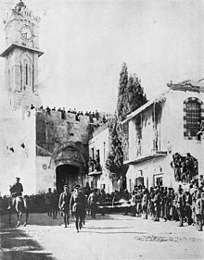
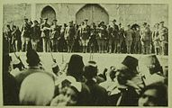
Jerusalem between Empires: Surrender and Transition

Slide 9
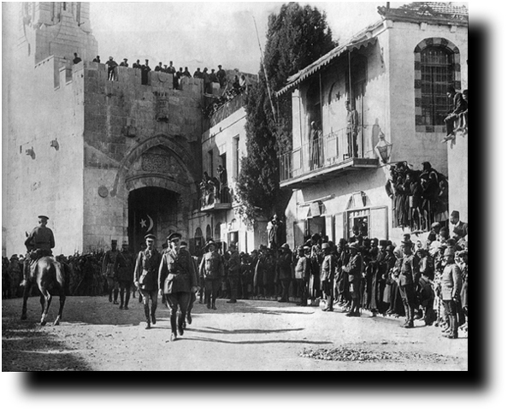
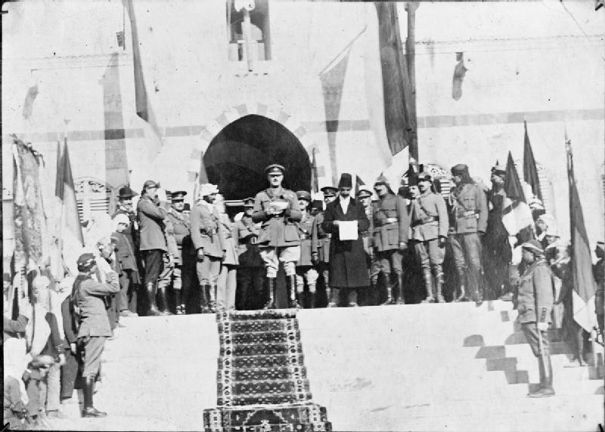

Slide 10
“The is not a Holy City…”
“The first glimpse of the city doesn’t give an impression of a “Holy’ or ‘Golden’ city, but of a filthy and muddy place.(…) The people are the dirtiest I have ever seen. I am sure some of them have never had a wash in all their lives… none of the ordinary natives had indulged in a shave…” (Private C.T. Shaw)
“There are many wandering vendors in the streets, selling cakes of various descriptions, bread, matches and other things. On the whole I am rather disappointed by this place…The shops I have seen are all natives, mostly dirty and untidy. There are no European shops, except the Anglo-American store which is situated just inside the Jaffa Gate.” (Private Herbert Empson)

Slide 11
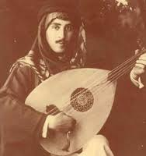
Missing the Ottomans…
“One could not possible describe those days and nights, for as soon as the Turkish nightmare was over, everyone felt like a newborn and started eating, drinking, and spending and squandering their money, the economy having improved immediately with the start of the British occupation.”
“I wish we had remained under their [the Ottomans] rule, because we later realized that our country and homeland had been secretly sold.”
Salim Tamari and Issam Nassar (Eds.), The Storyteller of Jerusalem: The Life and Times of Wasif Jawhariyyeh, 1904-1948,pp. 111, 122

Slide 12
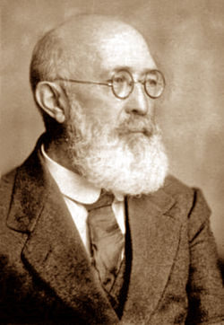
“Jerusalem was occupied- Jerusalem was liberated… Savages who do not comprehend your beauty will no longer rule you (Jerusalem).”
"I have often noted the good attitude of the Turkish army towards the inhabitant’s property, during their withdrawal […] They did not loot and did not touch our property[…] the general attitude of the Turkish army, one should admit, was good. However, we do not see good attitude of the British. The British soldiers destroy houses in Tel Aviv […] they break doors and throw away furniture, households and books […] and they also give some of [the property] to the Arabs.”
Mordechai Ben Hillel Hacohen

Slide 13
The complexity of the moment (and process) of inter-imperial transition
The important role that religion and religious divisions in Palestine played before, during and after the occupation of Jerusalem;
The British attempt to present the occupation as temporary, as a military rule and not a civic-religious one, and the reactions of the local population;
Was it indeed a Status Quo? The hopes and dissapointments from British occupation.

