Slide 1
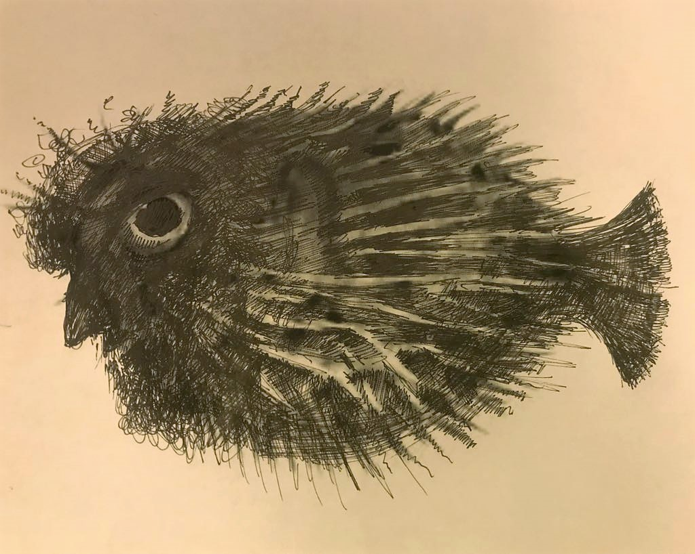
.
Япония и евреи: от тэнгу до фугу
(или От Потерянных Колен к Холокосту)
Евгений Штейнер
Japan Research Centre, SOAS, London
Школа Востоковедения, ВШЭ, Москва
28 февраля 2019
Библиотека Добролюбова
.

Slide 2
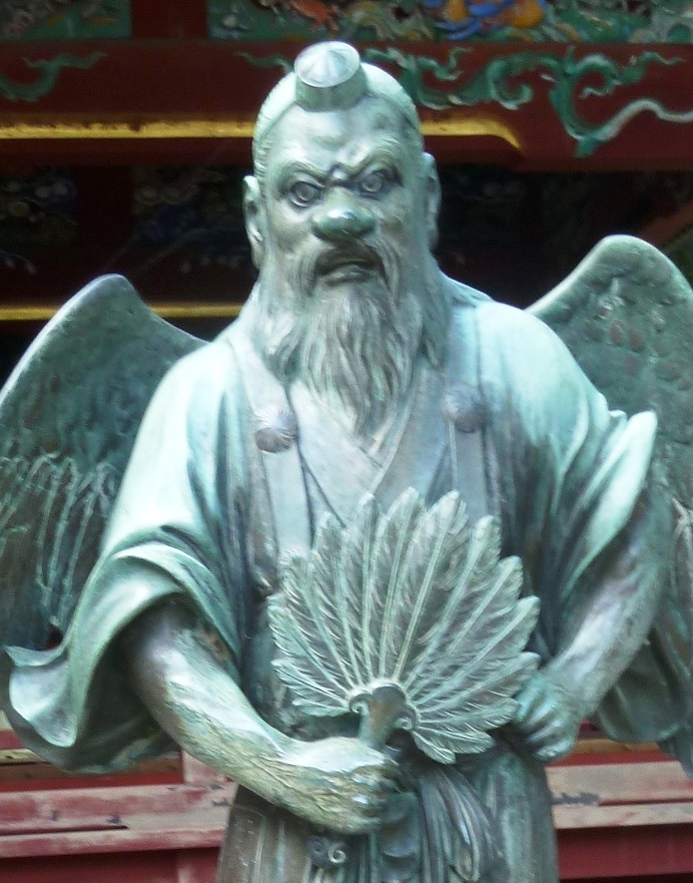
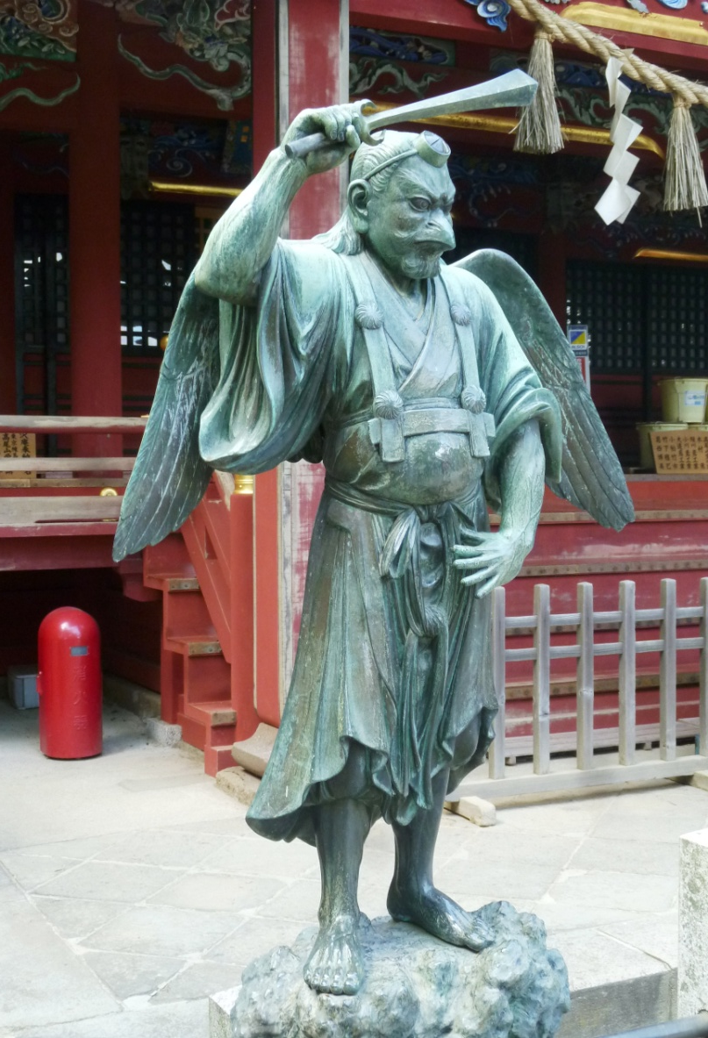
.
Legends of Ten Lost Tribes
Tengu 天狗
tokin 頭襟

Slide 3
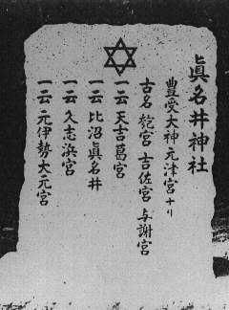
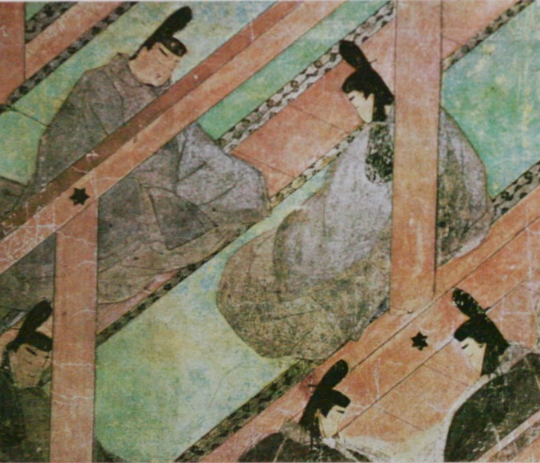
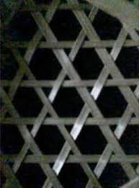
.
Star of David
Manai-jinja, Kyoto Pref.
Genji-monogatari scroll, 12 c.
Kagome 籠目 lattice

Slide 4
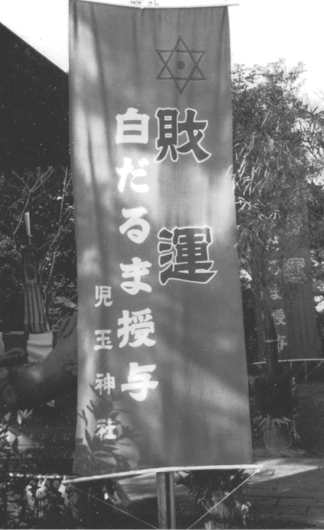
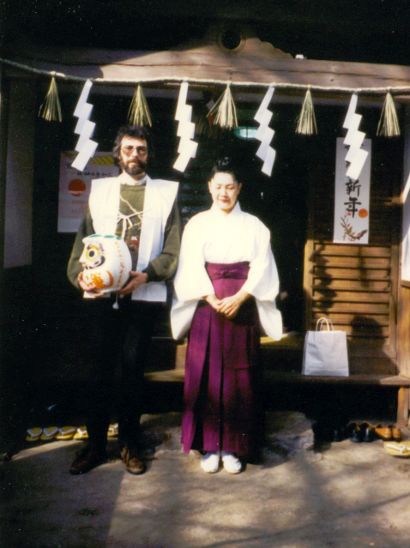
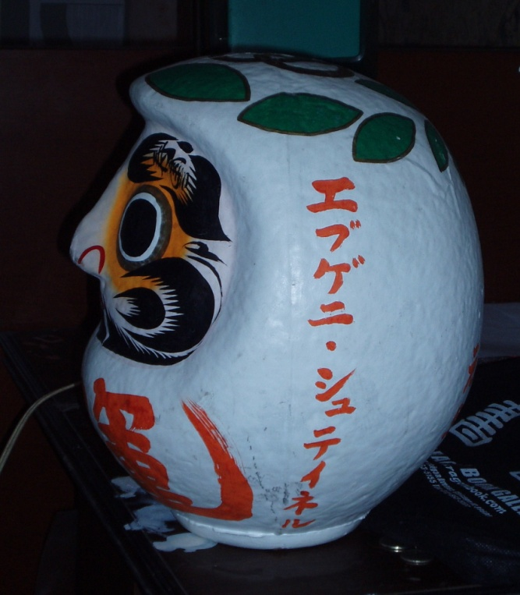
.
Kodama-jinja, Enoshima Island

Slide 5
.
Russian Jews in Japan
The Jewish Community of Japan was established March 21, 1953 (Tokyo), founded by merchant Jews primarily from Harbin and Shanghai. "The criteria to be a member were to be able to speak Russian, play poker and drink vodka,"
Ernie Salomon,
former community president
Before: Jewish Benevolent Association of Yokohama – Settlement #82 - from the Bluff Directory, 1923

Slide 6
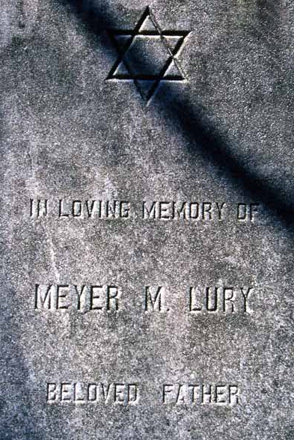
.
The Luri Brothers

Slide 7
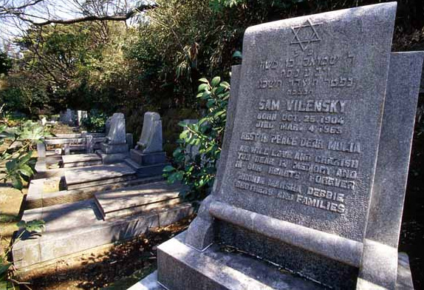
.
Sam Vilensky (1904-65)

Slide 8
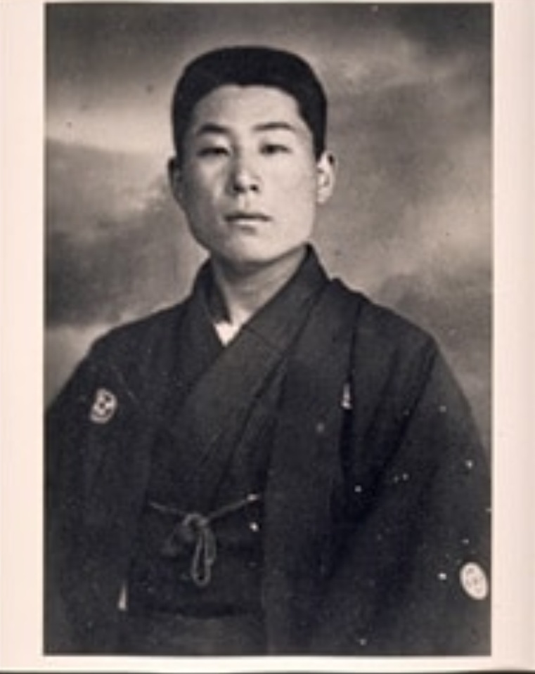
.
Chiune (Sinpo) Sugihara (1900-1986)

Slide 9
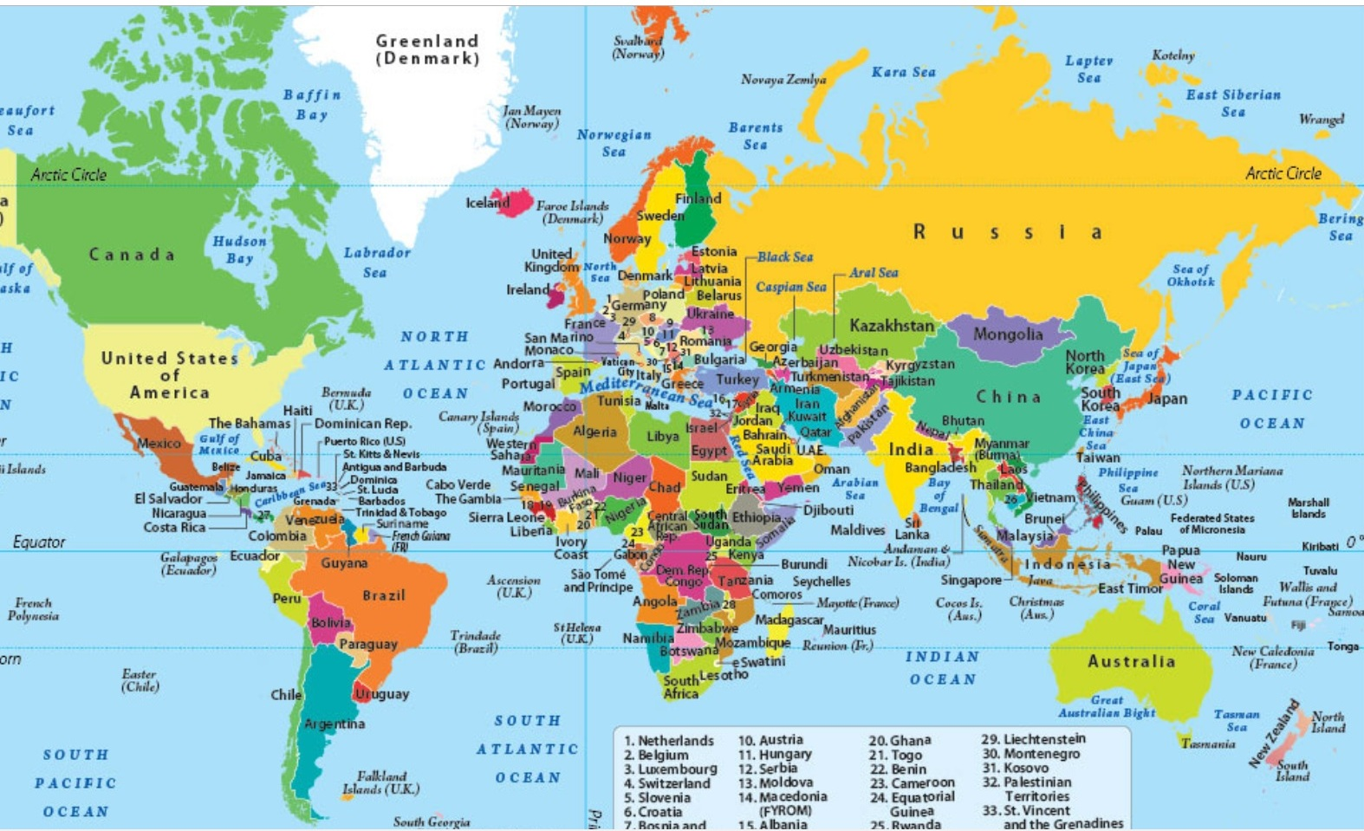
.
.

Slide 10
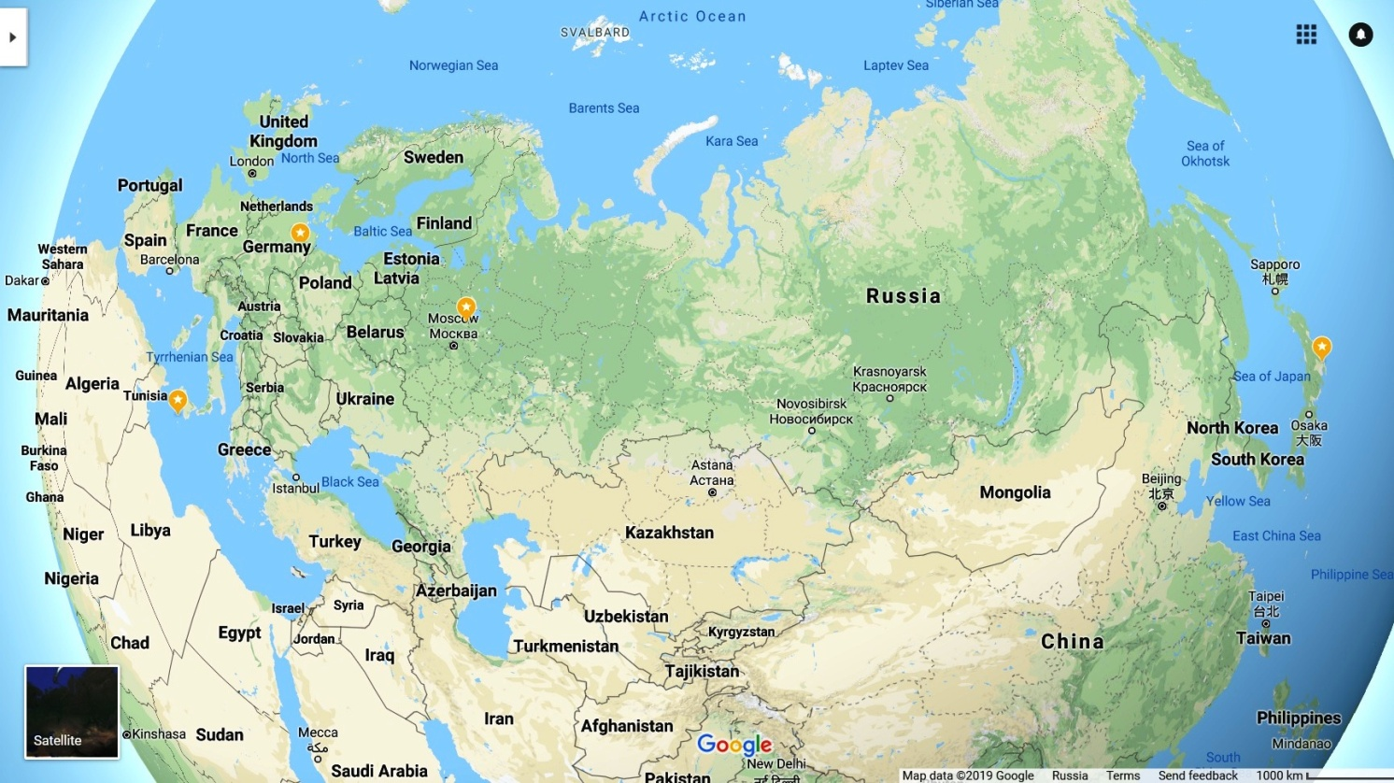
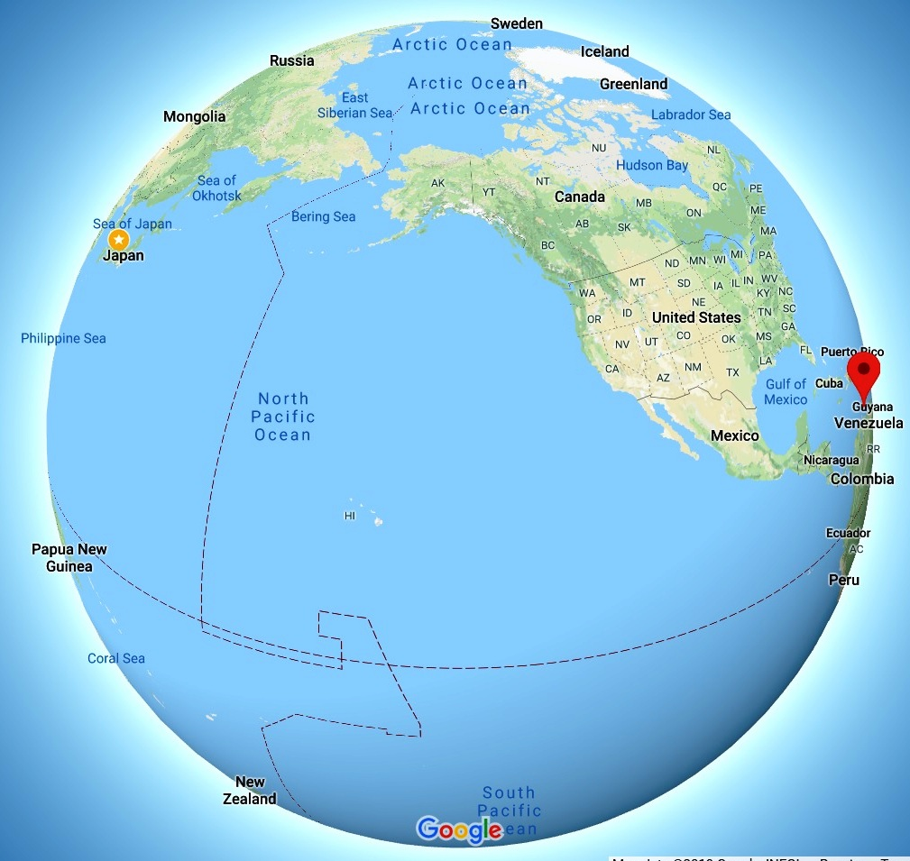
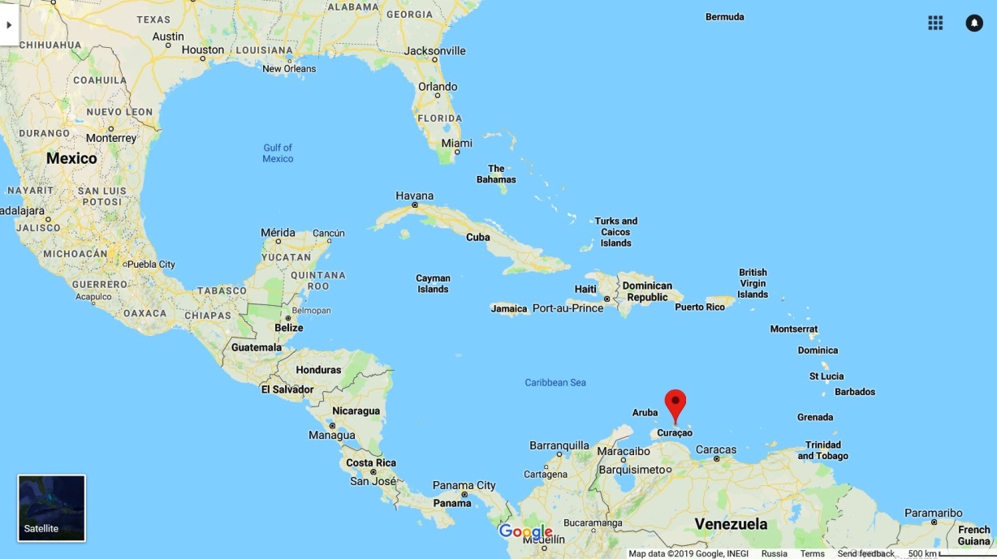
.
.

Slide 11
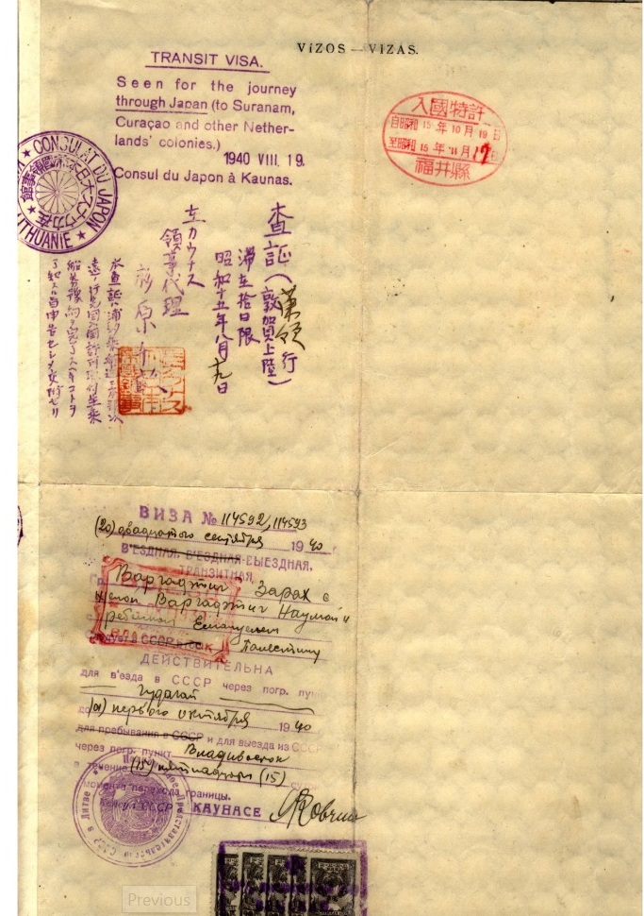
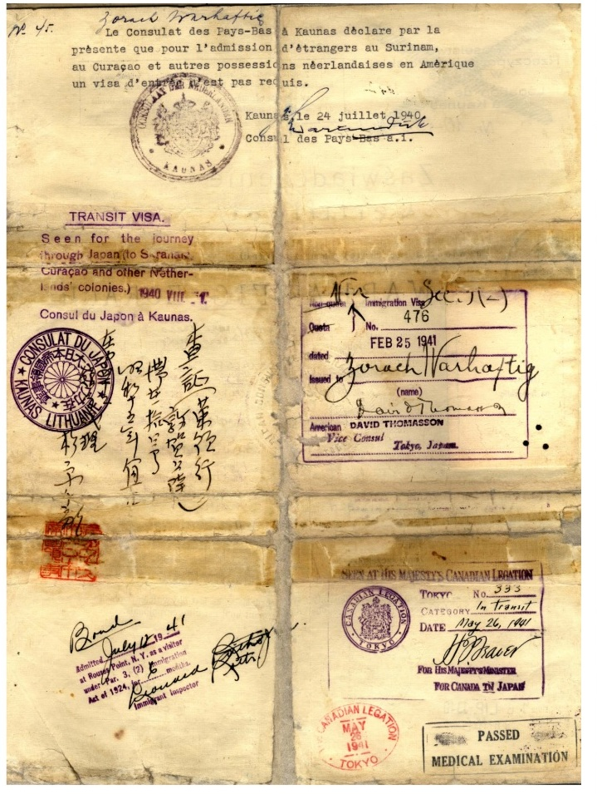
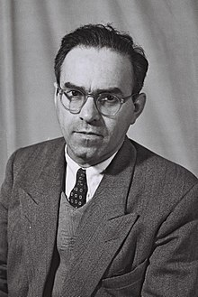
.
Zorach Warhaftig (1906-2002)

Slide 12
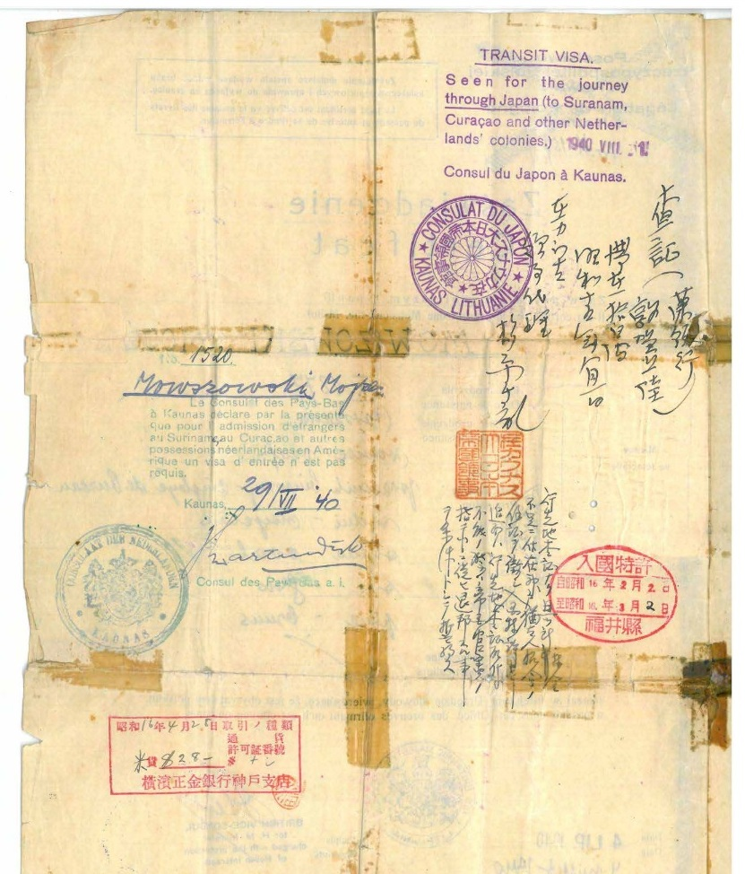
.
Sugihara’s visa

Slide 13
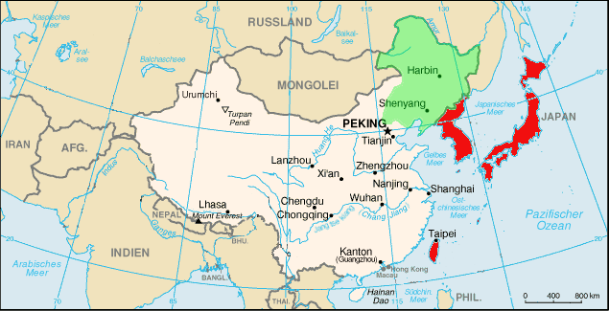
.
.

Slide 14
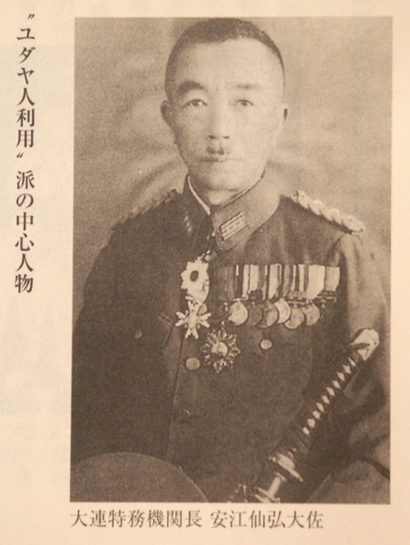
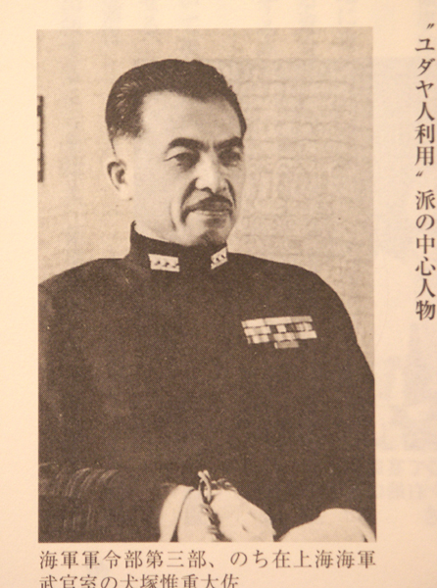
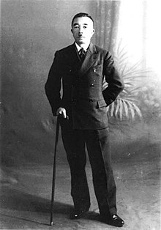
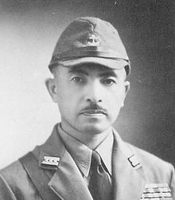
.
Norihiro Yasue (1886-1950, Gulag)
Inuzuka (1890-1965)

Slide 15
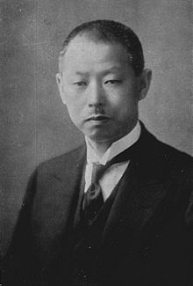
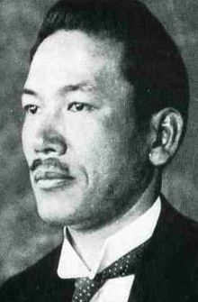
.
Higuchi Kiichiro (1882-1970) - R
Ayukawa Yoshisuke (1889-1967), founder of Nissan - L

Slide 16
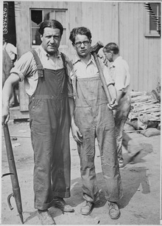
.
Dr. Stephen Wise (1874-1949)

Slide 17
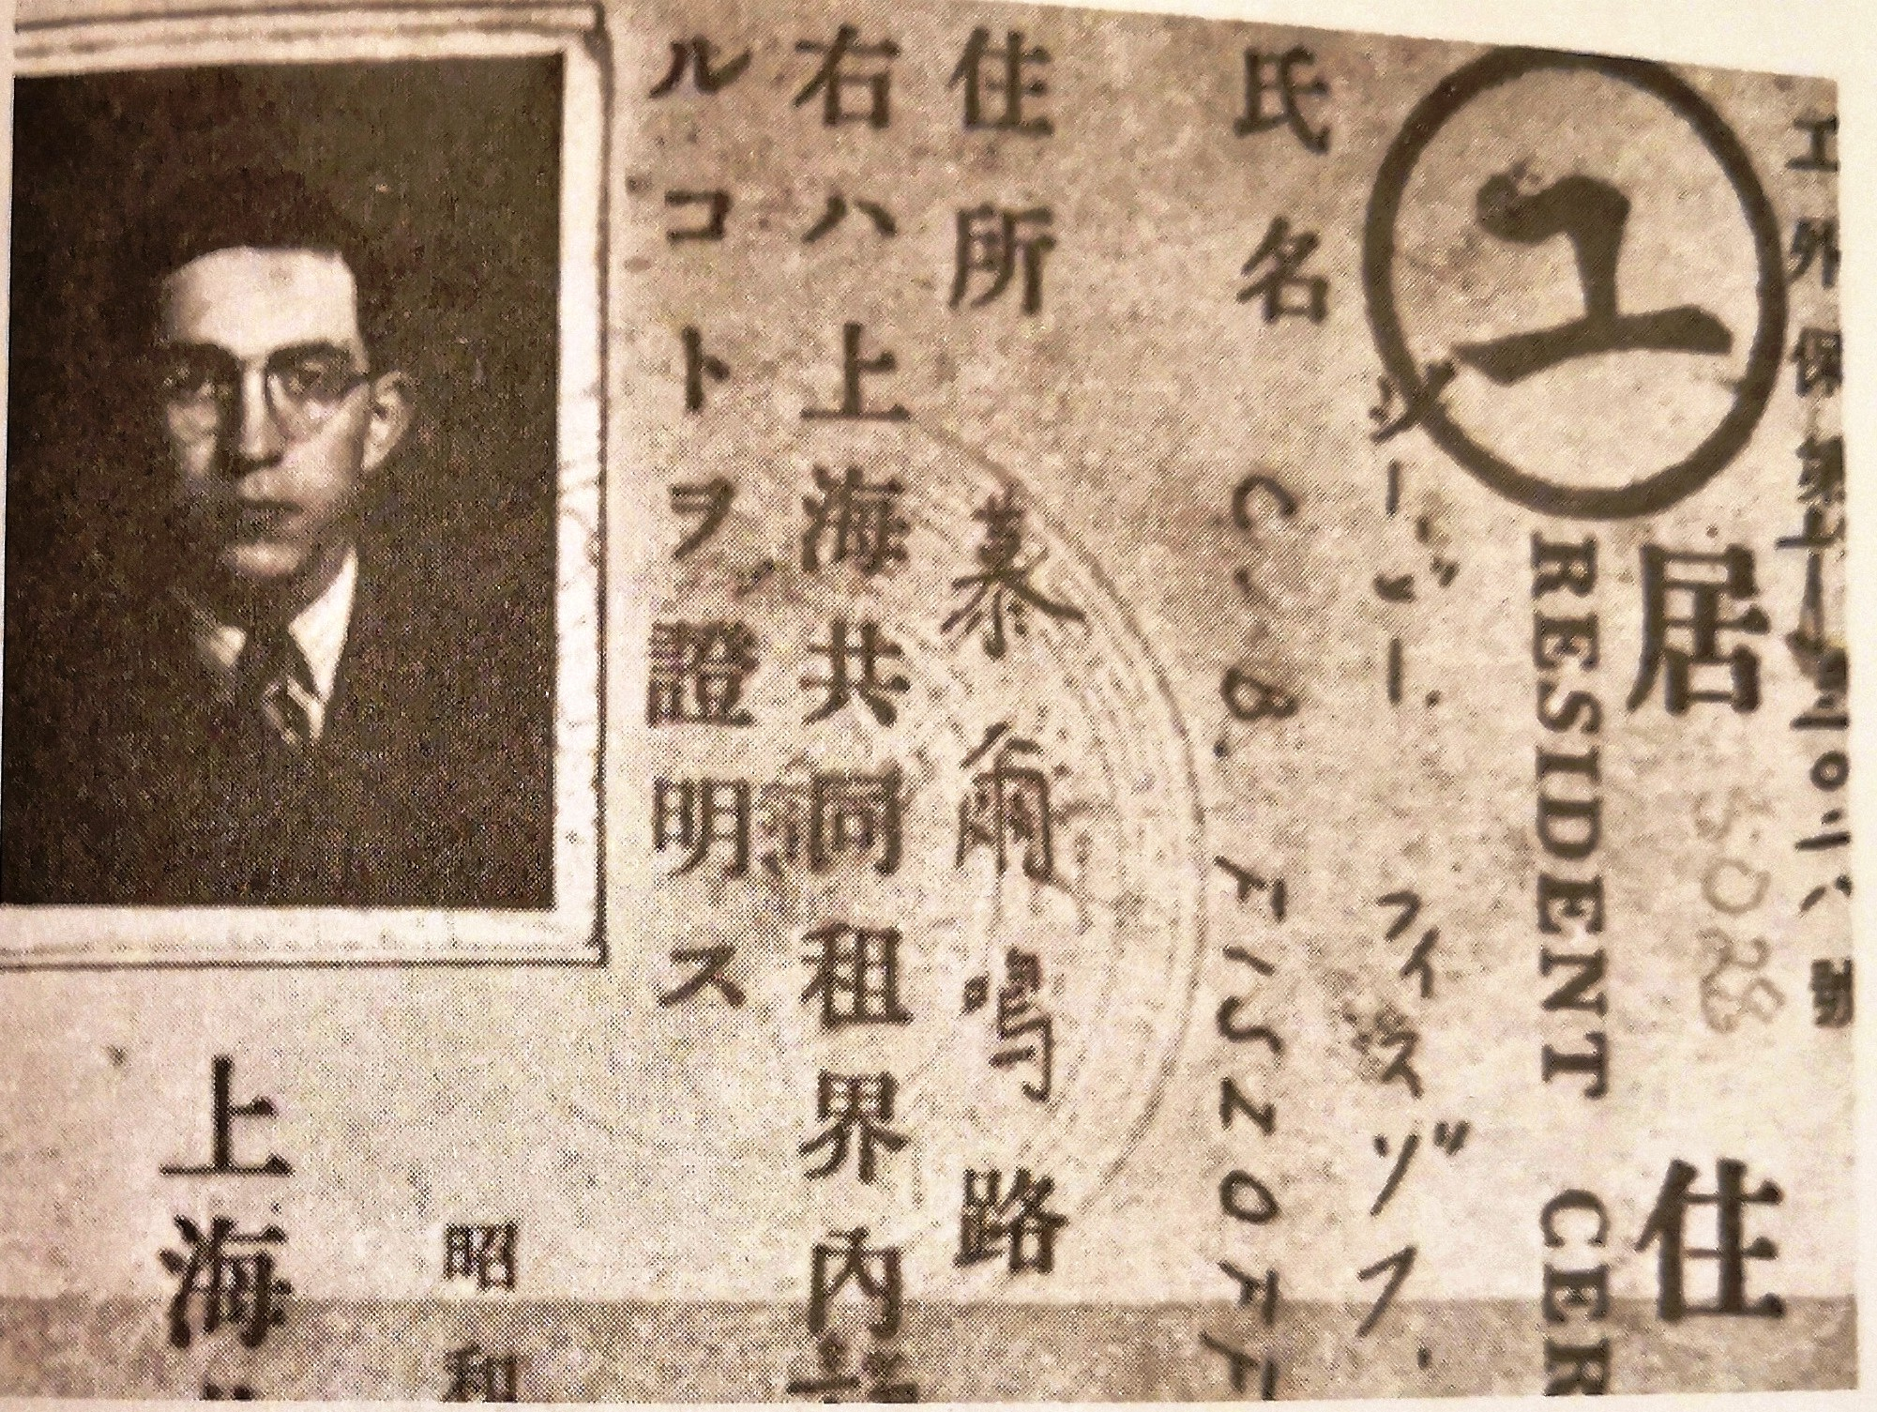
.
Residence Permit of C.B. Fiszoff, Shanghai

Slide 18
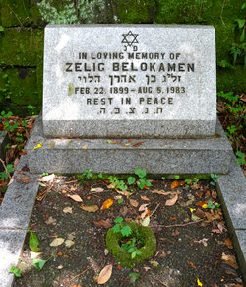
.
Zelig Belokamen (1899-1983),
Tientsin

Slide 19
WWII Refugees: Jacob Shimkin

Slide 20
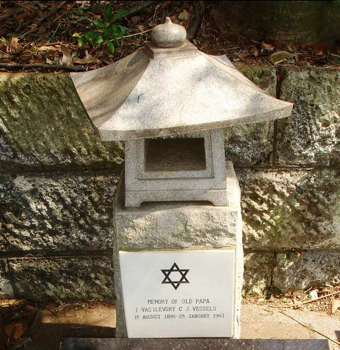
.
.

Slide 21
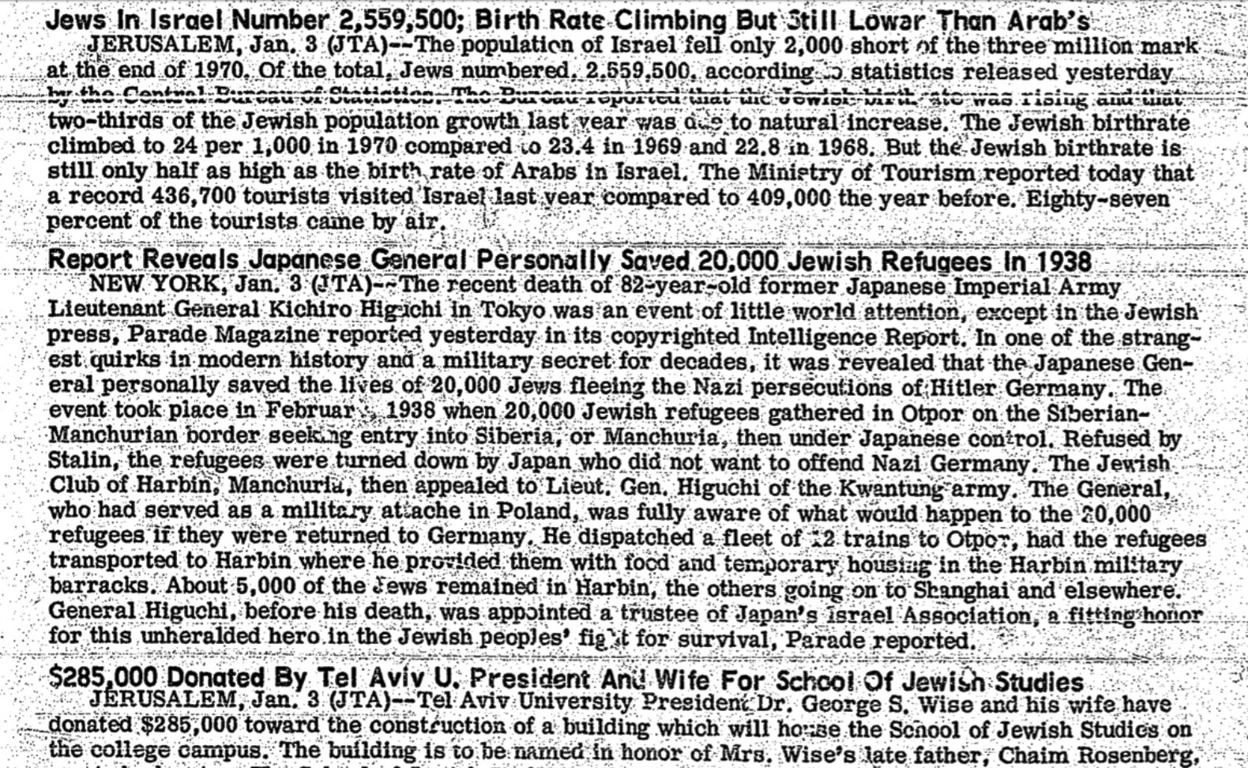
.
Otpor Incident, Feb. 1938

Slide 22
.
.

